Slide 1
CIT Signs and Symptoms
Presented by:
John FS Williams, M.Ed., LCPC and Mark Benson, LCPC

Slide 2
www.nami.org
Notes:
Family members of persons you may come into contact with may not always live in the area.
By directing families to www.nami.org
They can access information and find affiliates in their area.

Slide 3
Mental Health - Defined
Psychological well-being and satisfactory adjustment to the ordinary demands of life
Effective functioning in daily activities resulting in
Productive activities (work, school, caregiving)
Healthy relationships
Ability to adapt to change and cope with adversity

Slide 4
Mental Health - Continuum

Slide 5
Mental Illness – Defined
A brain disorder that affects a person’s thinking, feeling, moods and ability to relate to others.

Slide 6
Mental Illness – Defined in Illinois (405 ILCS 5/) Mental Health and Developmental Disabilities Code
Sec. 1-129. Mental illness. "Mental illness" means a mental, or emotional disorder that substantially impairs a person's thought, perception of reality, emotional process, judgment, behavior, or ability to cope with the ordinary demands of life, but does not include a developmental disability, dementia or Alzheimer's disease absent psychosis, a substance abuse disorder, or an abnormality manifested only by repeated criminal or otherwise antisocial conduct. (Source: P.A. 93-573, eff. 8-21-03.)

Slide 7
Mental Illness - Cause
Factors Attributed to the onset of symptoms
Genetics
Brain chemistry imbalance
Environment: Home, Family, Community
Excessive stress
Head Injury
Substance Use /Abuse
Persistent exposure to trauma (alters the brain development and functioning)

Slide 8
Mental Illness - Cause
Regardless of the cause, the effect is a biochemical change.
An imbalance in the chemistry of the brain
Injury
Structural abnormalities
Malfunction of a portion of the brain

Slide 10
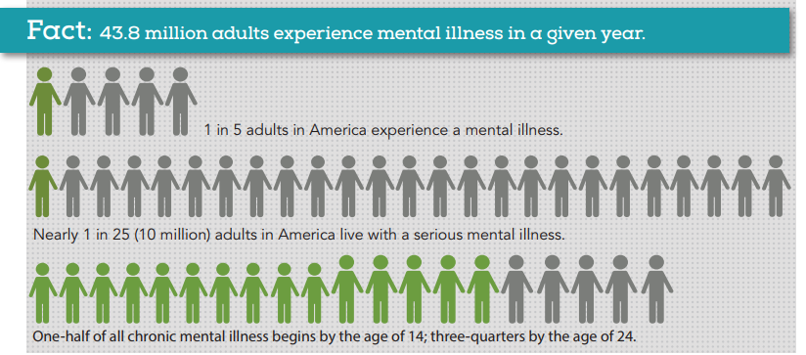
Mental Illness - Prevalence
NAMI – Oct 2015

Slide 11
Mental Illness - Prevalence

Slide 12
Mental Illness - Prevalence
2016 National Survey on Drug Use and Health (NSDUH)​
An estimated 44.7 million adults aged 18 or older in the United States live with some form of mental illness. (18.3% of all U.S. adults.)​
The prevalence of MI was higher among women (21.7%) than men (14.5%).​
Young adults aged 18-25 years had the highest prevalence of MI (22.1%) compared to adults aged 26-49 years (21.1%) and aged 50 and older (14.5%).

Slide 13
Mental Illness - Prevalence
2016 National Survey on Drug Use and Health (NSDUH)​
An estimated 10.4 million adults aged 18 or older in the United States live with a Serious Mental Illness. (4.2% of all U.S. adults.)​
The prevalence of SMI was higher among women (5.3%) than men (3.0%).​
Young adults aged 18-25 years had the highest prevalence of SMI (5.9%) compared to adults aged 26-49 years (5.3%) and aged 50 and older (2.7%).

Slide 14
Mental Illness - Prevalence
Most people with mental illnesses are NOT receiving treatment

Slide 15
Mental Health Treatment - Historically
1841 – Dorthea Dix
1880 – Nelly Bly
1907 – Indiana passes Eugenics Law
1946 – President Truman passes National Mental Health Act
1954 – “Thorazine” (chlorpromazine)
1955 – State hospital population peaks

Slide 16
Mental Health Treatment - Historically
1962 – One Flew Over the Cuckoo’s Nest
1963 – JFK signs Community Health Act, beginning Deinstitutionalization
1965 – Medicaid created – “institutions for mental diseases” no longer covered
1980 – Pres. Carter signs Mental Health Systems Act

Slide 17
Mental Health Treatment - Historically
1981 – Pres. Reagan signs Omnibus Budget Reconciliation Act, 30% reduction in federal spending
1990 – First FDA Approved antipsychotic to treat schizophrenia
2008 – Mental Health Parity and Addiction Act
2009 – Largest funding cut since deinstitutionalization
2010 – 14 beds per 100,000 people – the same as in 1850

Slide 18
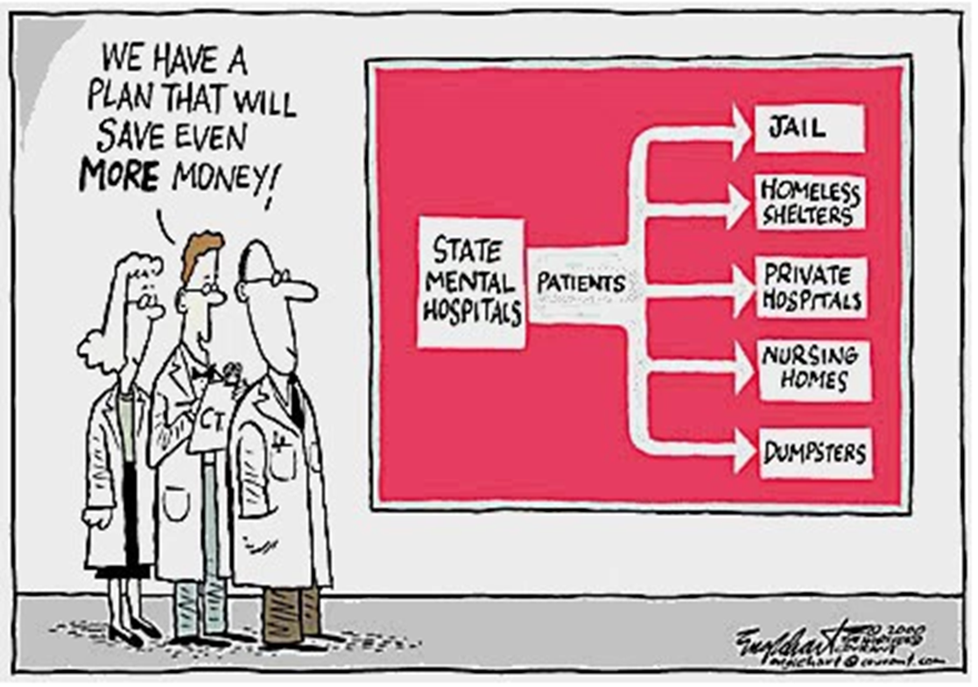
Deinstitutionalization
Minimally Adequate Treatment for individuals with severe mental illness
50 beds per 100,000 people
Illinois fails to meet the standard
9.3 beds per 100,000

Slide 19
Deinstitutionalization & Jail
With less availability, more and more individuals are ending up in jail.
Approximately 20% of inmates in jails and 15% of inmates in state prisons have a serious mental illness.
Cook County Jail is the largest mental health facility in Illinois.

Slide 20
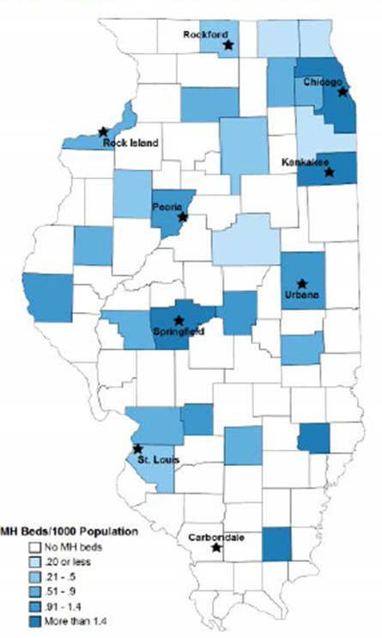
Illinois – 102 counties
80 counties have hospitals
222 hospitals
80 hospitals have authorized psychiatric beds
53 counties do NOT have psych beds
28 counties have inpatient behavioral health providers
Over half of the counties in IL lack sufficient numbers of psychiatrists

Slide 21
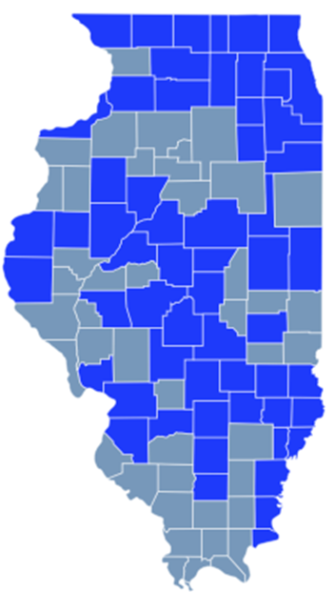
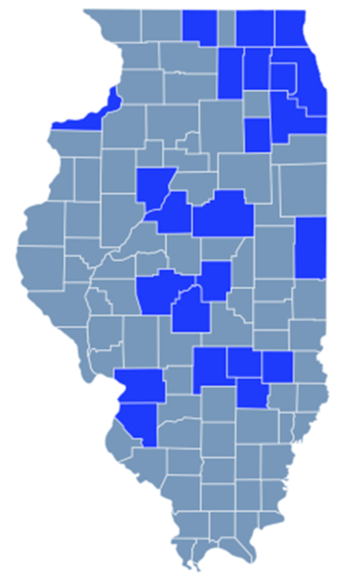
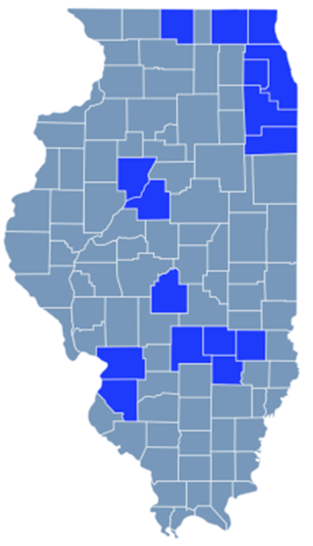
Problem-Solving Courts
More than 100 problem-solving courts in IL
DRUG MENTAL HEALTH VETERANS
http://www.ilcoe.us/problem-solving-courts/
Problem-Solving Courts in Illinois: Courtroom Innovation Favoring Adjustment Instead of Adjudication, A. Berens

Slide 22
Illinois – Mental Health Courts
23 Counties in Illinois
Fayette, Effingham, Jasper & Clay Counties
(730 ILCS 168/) Mental Health Court Treatment Act
Voluntary Participation ranging from 1-2 years
Individualized treatment plans
3 Models
Pre-Adjudicatory
Post-Adjudicatory
Post-Plea/Pre-Sentence

Slide 23
ALTERNATIVE PROSECUTION
ALTERNATIVE SENTENCING
Allows offenders an opportunity to avoid traditional prosecution
Often recommended by defense
MUST be Non-violent Offenders
Victim MUST Agree
Misdemeanor and Felony Offenses Included
Charges are Dismissed upon Successful Completion
Expungable
Post-conviction, involving a plea of guilty
Eligibility determined by the prosecution
Probation with treatment
Non-violent offenders
Victim MUST agree
All convictions vacated and cases dismissed upon successful completion
Expungable
COOK COUNTY STATE’S ATTORNEY’S OFFICE 2016 Presentation ASA A. Aakre
Notes:
ADD IN SLIDES FROM LA PRESENT
Most Illinois mental health courts are post adjudication. Many courts consist of individuals who were arrested while attempting to access mental health services or receiving mental health services (arrests from hospital ER, mental health unit or mental health center)

Slide 24
Mental Illness – Barriers to Care
Accessibility
Insurance
Stigma
Denial
Lack of mental health literacy
Distrust in the mental health profession

Slide 25
Mental Illness
Cancer
Unstable
Violent
Crazy
Unpredictable
Nuts
Mental
Scary
Difficult
Weak
Fighter
Hero
Resilient
Unfortunate
Innocent
A Trooper

Slide 26
Mental Illness – STIGMA
Fear and exclusion​
Authoritarianism​
Benevolence​
Poor social support​
Poorer subjective quality of life​
Low self esteem

Slide 27
Mental Illness – STIGMA
Talk openly about mental health​
Educate yourself and others​
Be conscious of language​
Encourage equality between physical illness and mental illness​
Be aware of your attitudes and behavior​
Focus on the positive​
Support people​

Slide 28
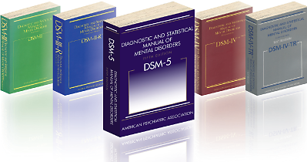
Diagnostic & Statistical Manual of Mental Disorders (DSM)
Lists 297 mental disorders (106 in 1952)
Published by the American Psychiatric Association (APA)
Has had multiple revisions
Offers a common language and standard criteria for the classification of mental disorders

Slide 29
Mental Illness – General Signs/Symptoms
Withdrawal
Change in functioning
Problems thinking
Increased sensitivity
Apathy
Feeling disconnected
Illogical/“Magical” thinking
Nervousness
Unusual behavior
Sleep or appetite changes
Mood changes
Notes:
One or two of these symptoms alone can’t predict a mental illness. But if a person is experiencing several at one time and the symptoms are causing serious problems in the ability to study, work or relate to others, he/she should be seen by a mental health professional. People with suicidal thoughts or intent, or thoughts of harming others, need immediate attention.

Slide 30
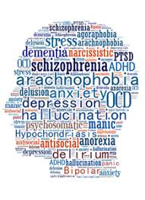
Mental Illness – Types of Mental Illness
Anxiety Disorders
Obsessive Compulsive Disorders ​
Trauma & Stress Disorders
Depressive Disorders ​
Bipolar Disorders​
Psychotic Spectrum Disorders​
Personality Disorders
Notes:
One or two of these symptoms alone can’t predict a mental illness. But if a person is experiencing several at one time and the symptoms are causing serious problems in the ability to study, work or relate to others, he/she should be seen by a mental health professional. People with suicidal thoughts or intent, or thoughts of harming others, need immediate attention.

Slide 31
Anxiety Disorders
Anxiety is a normal reaction to stress and can be beneficial in some situations. It can alert us to dangers and help us prepare and pay attention.
Anxiety Disorders occur when the anxiety response is:
Out of Proportion
Hinders the ability to function/perform accordingly

Slide 32
Anxiety Disorders
Several Types:
generalized anxiety disorder
panic disorder
social anxiety disorder
specific phobias
separation anxiety
medication-induced anxiety
All anxiety disorders have one thing in common: persistent, excessive fear or worry in situations that are not threatening.

Slide 33
Anxiety Disorders – Panic Disorder
Recurrent, unexpected panic attacks
Abrupt surge of intense fear or discomfort with at least 4 of the following:
Palpitations, pounding heart, increased heart rate
Sweating
Trembling
Shortness of breath
Feeling of choking
Chest pain
Nausea
Feeling dizzy, unsteady, light-headed or faint
Chills or heat sensations
Numbness, tingling sensation
Feeling of being detached from oneself
Fear of losing control
Fear of dying
Symptoms can mimic that of a heart attack

Slide 34
Obsessive Compulsive Disorder (OCD)
Experiences obsessions, compulsions, or both​
Obsessions or compulsions are time consuming or cause significant distress or impairment​
2% of the population has it at some point in his/her life​
Is 2-3x’s more common than schizophrenia or bipolar disorder​

Slide 35
Obsessive Compulsive Disorder (OCD)
Obsessions​
Recurrent and persistent unwanted thoughts, impulses, or images ​
Person attempts to ignore, suppress, or neutralize them ​
Compulsions​
Repetitive rituals or repeated actions that someone feels they must perform to avoid negative consequences or to reduce anxiety – intentional but involuntary

Slide 36
Personality Disorders
Personality is the way of thinking, feeling and behaving that makes a person different from other people. An individual’s personality is influenced by experiences, environment (surroundings, life situations) and inherited characteristics.
A personality disorder is a way of thinking, feeling and behaving that deviates from the expectations of the culture, causes distress or problems functioning, and lasts over time.
American Psychiatric Association

Slide 37
Personality Disorders
Does not disrupt emotional, intellectual or perceptual functioning
Begins by late adolescence or early adulthood, and causes distress or problems in functioning
Medication is minimally effective
Individuals struggle to change because they often view the behavior as justified
Without treatment, the behavior/experience is inflexible and usually long-lasting

Slide 38
Personality Disorders
Clues to Look For:
Blaming others for their problems
Initially charming and engaging
Sounds like an expert
Will talk about how medication and other treatments provide little help
Has no, or few, lasting relationships

Slide 39
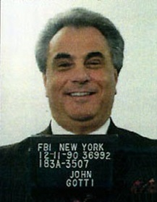
Antisocial Personality Disorder
View of the world: dog-eat-dog​
View of themselves: superior​
View of others: suckers​
Deals with the world by: opportunism
John Gotti – Gambino Crime Family

Slide 40
Antisocial Personality Disorder
Disregard for right and wrong
Persistent lying or deceit to exploit others
Being callous, cynical and disrespectful of others
Using charm or wit to manipulate others for personal gain or personal pleasure
Arrogance, a sense of superiority and being extremely opinionated
Recurring problems with the law, including criminal behavior
Repeatedly violating the rights of others through intimidation and dishonesty

Slide 41
Antisocial Personality Disorder
Impulsiveness or failure to plan ahead
Hostility, significant irritability, agitation, aggression or violence
Lack of empathy for others and lack of remorse about harming others
Unnecessary risk-taking or dangerous behavior with no regard for the safety of self or others
Poor or abusive relationships

Slide 42
Antisocial Personality Disorder
Failure to consider the negative consequences of behavior or learn from them
Being consistently irresponsible and repeatedly failing to fulfill work or financial obligations
Often show signs of Conduct Disorder before the age of 15

Slide 43
Narcissistic Personality Disorder
View of the world: it’s theirs​
View of themselves: special
View of others: servants
Deals with the world by: image-management

Slide 44
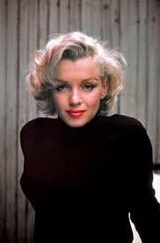
Borderline Personality Disorder
View of the world: rejecting​
View of themselves: vulnerable
View of others: angels or devils
Deals with the world by: emotional justification
Marilyn Monroe

Slide 45
Borderline Personality Disorder
Often misdiagnosed as Bipolar or Psychotic Disorder
People with Borderline Personality Disorder are:
In a chronic state of crisis
Desires love, but fears abandonment
Often the “frequent flyers” in ERs (EDs)
Often banned from treatment services due to outbursts

Slide 46
Mood Disorders
Also called affective disorders, may involve:
Feeling sad all the time
Losing interest in important parts of life
Fluctuating between extreme happiness and extreme sadness
The most common mood disorders are:
Depression
Bipolar Disorder
Seasonal Affective Disorder (SAD)
Self-Harm

Slide 47
Mood Disorders – Bipolar Disorder
Experience extreme variations in moods
Ups are called Mania
Downs are called Depression
Usually starts in teenage years, but children can be affected as well
Often lasts a lifetime

Slide 48
Mood Disorders – Bipolar Disorder
Mania (Manic Episode)
Distinct period of time with an elevated mood
Grandiose thinking and delusions
Increase in goal-directed behavior
Increase in pleasurable activities without regard for consequences
Hyperverbal
Decreased sleep
Increase Distractable

Slide 49
Mood Disorders - Depression
More than just a feeling of being "down in the dumps" or "blue”
Feelings persist and interfere with everyday life
Symptoms can include:
Sadness
Loss of interest or pleasure in activities you used to enjoy
Change in weight
Difficulty sleeping or oversleeping
Energy loss
Feelings of worthlessness
Thoughts of death or suicide

Slide 50
Suicide
Suicide - death caused by self-directed injurious behavior with intent to die as a result of the behavior.
Suicide Attempt - non-fatal, self-directed, potentially injurious behavior with intent to die as a result of the behavior.
Suicidal Ideation - thinking about, considering, or planning suicide.

Slide 51
Suicide

Slide 53
Suicide Warning Signs
Often talking or writing about death, dying, or suicide
Making comments about feeling hopeless, helpless or worthless
Expressions of having no reason to live; no sense of purpose in life; saying things like "It would be better if I wasn't here" or "I want out“
Talk about extreme guilt and shame
Feeling unbearable pain (emotional and physical)
Talking about anger and seeking revenge
Talking about feeling trapped or being a burden to others

Slide 54
Suicide Warning Signs
Increased alcohol and/or drug misuse
Change in eating and/or sleeping behaviors
Withdrawal from friends, family and community
Mood swings, sudden changes form sad to very calm/happy
Increase in anxiety or agitation
Reckless behavior or more risky activities, seemingly without thinking
Giving away important possessions
Putting affairs in order, making a will
Saying goodbye to friends and family

Slide 55
Self-Injurious Behavior
Self-injury occurs when someone intentionally and repeatedly harms herself/himself in a way that is impulsive and not intended to be lethal.​
The most common methods are:​
Skin cutting (70-90%),
Head banging or hitting (21%-44%)
Burning (15%-35%)

Slide 56
Self-Injurious Behavior
Other forms of self-injury include: ​
excessive scratching to the point of drawing blood,
punching self or objects​
inserting objects into body openings​
drinking something harmful ​
breaking bones purposefully

Slide 57
Self-Injurious Behavior
Why Self Harm?​
Distraction​
Releasing tension​
Feeling “something”​
Expressing self​
Punishment​
Rush of endorphins

Slide 58
Self-Injurious Behavior
Myth #1 – Self Harm is a failed suicide attempt
Strategy to maintain psychological stability
May actually prevent a suicide attempt
Myth #2 – People are doing it just to get attention
Most who harm themselves go to great lengths to hide the behavior​
Myth #3 – If the wounds are not “bad enough” then it’s not serious
Severity of the wounds does not always equal severity of the emotional distress
Notes:
#1 – a suicide risk assessment is still needed
#2 – it may be a cry for help
#3 - A

Slide 59
Self-Injurious Behavior - Signs
Scars, often in patterns
Fresh cuts, scratches, bruises, bite marks or other wounds
Excessive rubbing of an area to create a burn
Keeping sharp objects on hand
Wearing long sleeves or long pants, even in hot weather
Frequent reports of accidental injury
Difficulties in interpersonal relationships
Behavioral and emotional instability, impulsivity and unpredictability
Statements of helplessness, hopelessness or worthlessness

Slide 60
Thought/Psychotic Disorders
Schizophrenia
Psychotic Disorders
Drug-induced Psychosis

Slide 61
Thought/Psychotic Disorders - Schizophrenia
A chronic and severe mental disorder that affects how a person thinks, feels, and behaves. People with schizophrenia may seem like they have lost touch with reality.
Symptoms usually start between ages 16 and 30. In rare cases, children have schizophrenia
Positive, Negative and Cognitive Symptoms

Slide 62
Thought/Psychotic Disorders - Schizophrenia
Positive Symptoms – psychotic behaviors not generally seen in healthy people. People with positive symptoms may “lose touch” with some aspects of reality.
Hallucinations – False Sensory Perceptions
Auditory (most common)
Visual
Tactile
Olfactory
Gustatory

Slide 63
Hallucinations
SYMPTOM – Not an illness
Hallucinations can result from other illnesses or events that are traumatic to the brain.
Intoxication
Injury or illness (stroke, encephalitis)
Oxygen (too much or too little)
Alteration in physical status
Trauma or shock (auto accident, robbery)
Mental Illness

Slide 64
Thought/Psychotic Disorders - Schizophrenia
Positive Symptoms continued
Delusions: Fixed False Beliefs
Persecutory: one will be harmed by individual or organization
Referential: Environmental cues are being directed to the individual (tv/radio)
Grandiose: Belief they have exceptional abilities, wealth, fame
Nihilistic: Conviction a major catastrophe will occur
Bizarre: Thought insertion, thought withdrawal, control of others
Thought Disorders (unusual or dysfunctional ways of thinking)

Slide 65
Thought/Psychotic Disorders - Schizophrenia
Negative Symptoms - disruptions to normal emotions and behaviors
“Flat affect” (reduced expression of emotions via facial expression or voice tone)
Difficulty beginning and sustaining activities
Reduced speaking
Anosognosia

Slide 66
Thought/Psychotic Disorders - Schizophrenia
Anosognosia is a deficit of self-awareness, a condition in which a person with a disability seems unaware of its existence.
Lack of insight into one’s illness​
50% of people living with Schizophrenia​
40% of people living with Bipolar Disorder​
Raises incidence of non-adherence to medication​
Notes:
Would you engage in treatment for an illness you didn’t believe you have???

Slide 67
Thought/Psychotic Disorders - Schizophrenia
Cognitive Symptoms - changes in memory or other aspects of thinking
Poor “executive functioning” (the ability to understand information and use it to make decisions)
Trouble focusing or paying attention
Problems with “working memory” (the ability to use information immediately after learning it)

Slide 68
Thought/Psychotic Disorders -Psychosis
How to deal with someone who may be psychotic:
Do not try to argue out of delusional thinking
Do not say “I hear voices too”
Keep distance without sudden moves
Display hands
Announce intentions
Maintain eye contact but do not stare/intimidate

Slide 69
Treatment
Hospitalization stabilizes acute symptoms to reduce threat
Focus of community treatment is integration
Mental health code focuses on an individual’s rights
Legal system is the system of last resort
Criminalization of the mentally ill

Slide 70
Communication Tip Reminders
Their adrenaline is skyrocketing
The person may be terrified by his/her own feelings of loss of control
They may act in bizarre, angry or hostile ways
Actions are motivated by fear, anxiety & insecurity
They want to know how much trouble they are in
They may be very confused
Concern about what the neighbors might think

Slide 71
Build TRUST with Family Members
Has the person had positive or negative interactions with police in the past?
What has WORKED in the PAST?
Does the person take medication? – if so, have they stopped and for how long?
Is the person using any other substance(s)?

Slide 72
Resources
Do you have knowledge of services provided,
an address, phone number, or contact person?
Community Mental Health Providers
Hospitals
Substance Use Centers
Advocacy Groups
Legal Assistance
Housing
Shelters, Crisis, Group or Nursing Homes, Independent
School/College
Family Support Groups
Peer Groups
Hotlines

Slide 73
Resources
NAMI Barrington Area
NAMI Champaign
NAMI Chicago
NAMI Cook County North Suburban
NAMI Greater Decatur
NAMI Jackson County
NAMI Kane County North
NAMI Kane-South, DeKalb and Kendall Counties
NAMI Kankakee County
NAMI Livingston/McLean Counties
NAMI McHenry County
NAMI Metro Suburban
NAMI Metropolis/Southernmost IL
NAMI Mt. Vernon
NAMI Northern Illinois
NAMI Northwest Suburban
NAMI of DuPage County Illinois
NAMI of Lake County
NAMI Sauk Area
NAMI Schaumburg Area
NAMI South Suburbs of Chicago
NAMI Southeastern Illinois
NAMI Southern Illinois University - Carbondale
NAMI Southwest
NAMI Southwestern Illinois
NAMI Springfield (IL)
NAMI Stephenson County
NAMI Tri-County Illinois
NAMI University of Illinois -Urbana Champaign
NAMI Will-Grundy

Slide 74
www.nami.org
Notes:
Family members of persons you may come into contact with may not always live in the area.
By directing families to www.nami.org
They can access information and find affiliates in their area.

