Slide 1
Autism Spectrum Disorder & Intellectual Disabilities
Sara Hinkle BCBA LBA
Notes:
Should I add Julie Alderman MA LPCP

Slide 2
Developmental Disabilities
A group of conditions with impairment in the following areas
Physical, cognitive, learning, language, or behavior areas
Difficulty with language, mobility, self-help, independent living
Most begin before the baby is born but some may happen after birth because of
Injury
Infection
Or other factors and can be diagnosed later in life
May impact day to day functioning and usually last throughout a person’s lifetime
Not everyone with a developmental disorder has intellectual impairment
(Centers for Disease Control and Prevention – 2022)

Slide 3
Types of Developmental Disabilities
Vision & Hearing Impairment
Intellectual Impairment
Seizure Disorders
Attention Deficit Disorder
Cerebral Palsy
Fetal Alcohol Syndrome
Down Syndrome
Fragile X Syndrome
Autism Spectrum Disorder
Notes:
*CDC does not list seizure disorders on their developmental disabilities page any longer

Slide 4
Seizure Disorders
May be a single or recurrent neurological event
Sometimes result in strange sensations, emotions, and/or behavior
Seizures are caused by abnormality in brain “wiring” and/or imbalance in brain chemicals (neurotransmitters)
Two types of seizures:
Generalized seizures – affect both sides of the brain (may result in 911 call)
Focal seizures – located in just one area of the brain aka partial seizures
Epilepsy: broad term used for a brain disorder that causes seizures, different types of epilepsy just like there are different types of seizures
(Centers for Disease Control and Prevention – 2020)

Slide 5
Attention Deficit Disorder
with or without Hyperactivity
One of the most common neurodevelopmental disorders of childhood and often lasts into adulthood
Symptoms can be severe and can cause difficulty in home, school, or with friends
Treatable medical condition
Genetics & brain chemistry imbalance may be causes

Slide 6
Attention Deficit Disorder
with or without Hyperactivity
Symptoms
Easily distracted
Difficulty following through on instructions
Forgetful and disorganized
Fidgeting, running around/climbing
Impulsive
Talking excessively, interrupting or intruding
Difficulty waiting for a turn
Difficulty getting along with others
Does not appear to be listening

Slide 7
Cerebral Palsy
A disorder of movement, muscle tone and/or posture
Caused by damage that occurs to the brain (birth to age 5)
Symptoms can change over time, but does not get worse
Rigidity/floppiness of the limbs and/or trunk
Abnormal posture, involuntary movements
Eye muscle imbalance (eye focus)
Ability to walk is impaired

Slide 8
Fetal Alcohol Syndrome
A disability with cognitive, physical and behavioral components
Caused by consumption of alcohol during pregnancy and how it affects the fetus
Damage to the fetus can occur at any point in the pregnancy – even in the early stages when the mother is unaware of the pregnancy
Binge drinking and regular heavy drinking put a fetus at the greatest risk
(National Institute on Alcohol Abuse and Alcoholism)

Slide 9
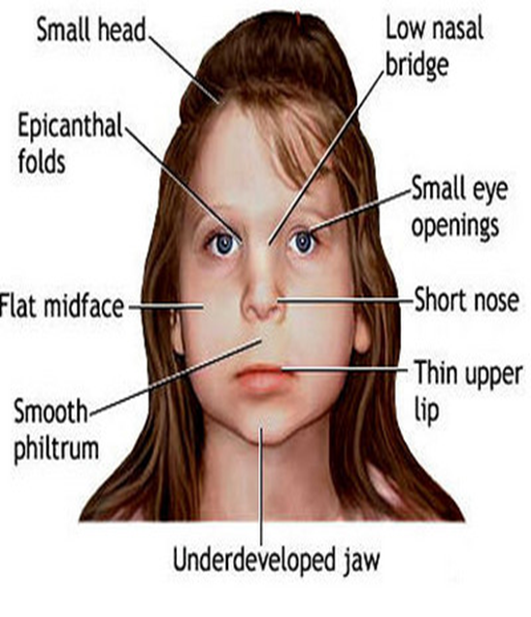
Fetal Alcohol Syndrome
Common Attributes
Physical
Abnormal Appearance
Short Height
Low Body Weight
Small Head Size
Poor Coordination
Developmental
Low IQ
Hearing and/or Visual Deficits
Behavioral
Problems with Emotional Control
Socially Naïve
May have substance abuse problems
Impulse control problems/high risk behavior
Do not always understand the consequences of their actions

Slide 10
Fragile X Syndrome
One of the most common causes of inherited intellectual disability
Genetic disorder
People with FXS do not make a particular protein that aids in brain development
Affects males and females, however females tend to have milder symptoms
No cure but various treatments help with symptoms
Autism spectrum disorder also occurs more frequently in people with FXS
Symptoms:
Developmental delays
Learning disabilities
Social and behavior problems: such as, lack of eye contact, anxiety, trouble paying attention, impulsive, and self-stimulatory behaviors such as hand flapping

Slide 11
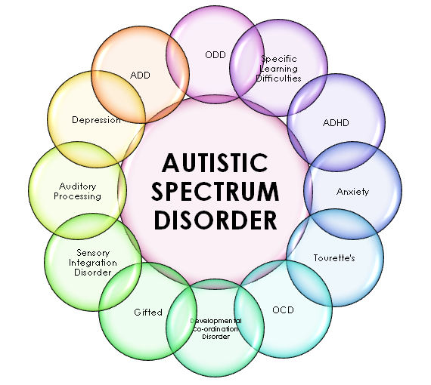
Developmental Disorders
“Hidden Disabilities”
Psychiatric disorders
Mood disorders
Anxiety disorders
Personality Disorders
Intellectual Disorders
It is often difficult to determine what is causing the unusual behavior

Slide 12
Officers need to know this about serving/protecting those with DD
Large segment of the population
A high functioning individual may not disclose a disability
Individuals may not have a diagnosis (adults or children)
Physical appearance may not be a clue for DD
Unusual behavior with no apparent cause
Limit the use of force or use as a last resort…
Calming & de-escalation techniques work best!

Slide 13
Behavior is communication
Notes:
If an individual is engaging in problem behavior they are trying to communicate something.

Slide 14
01
Autism Spectrum Disorder

Slide 15
Autism Spectrum Disorder (ASD)
A developmental disorder that involves challenges in social interaction, communication, cognition, and includes repetitive behaviors. ASD presents differently for each individual.
Notes:
If you’ve met one person with autism, then you’ve met one person with autism.

Slide 16
Why train officers on the topic of Autism?
Youth population “aging out”
Officer citizen safety
Make the best use of time and resources
Avoid litigation and negative press coverage

Slide 17
Symbols of Autism
Ribbon, puzzle pieces, primary colors
Autism Awareness Month is April and the symbolic color is blue
Symbols may be on license plates, cars, window clings, stickers, bracelets, or shirts

Slide 18
Statistics
Gender
Age
Demographics
Boys are 4x’s more likely to be diagnosed than girls
Most children are diagnosed after age 4, but ASD can be diagnosed as early as 2
Effects all ethnic & socioeconomic groups
1 in 34
1 in 144
2-4
4+
In 2021, CDC reported that 1 in 54 children in the US are diagnosed with ASD

Slide 19
Common medical issues of individuals with ASD
Epilepsy
Heart conditions
Asthma
Gastrointestinal issues
Severe food, drug, & environmental allergies
*Vulnerable to medication interactions and may be on multiple medications*

Slide 20
ASD Characteristics
Communication
Social Interaction
Sensory Abilities
Repetitive Behaviors
Cognitive Processing
May have limited verbal communication/non-verbal
Differences in understanding communication
Echolalia or unusual speech
May need help navigating social cues
Difficulty understanding emotions/feelings
May need limited sensory stimulation
May avoid sensory stimuli
May engage in self-soothing behavior
May repeat words/phrases
May have repetitive patterns of behavior
May be resistant to change
May need extra processing time
May need help with flexibility
May have difficulty generalizing skills across settings & people
Notes:
Communication: difficulty with slang, jokes, sarcasm

Slide 21
Social Skills Interaction
Social/emotional reciprocity
Perspective taking
Initiating or responding to social interactions
Non-verbal communication
Eye contact and difficulty reading facial expressions
Developing, understanding and maintaining friendships
Adjusting behavior to suit various social contexts
Concrete thinking

Slide 22
Communication
High percentage of non-verbal or limited verbal capabilities
Irregularities of voice tone and/or volume
Difficulty understanding and processing
Words with multiple meanings
Slang, jokes, sarcasm
Echolalia, repetitive and/or unusual speech

Slide 23
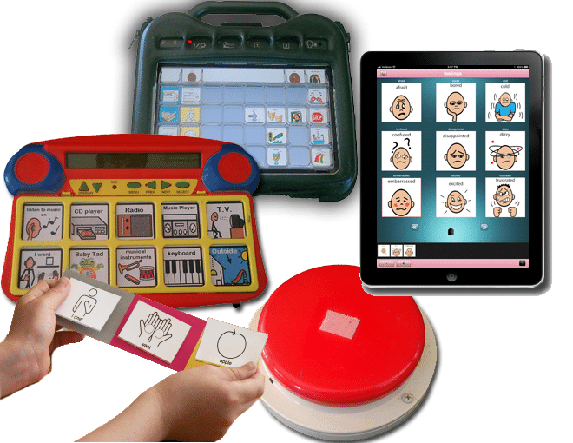
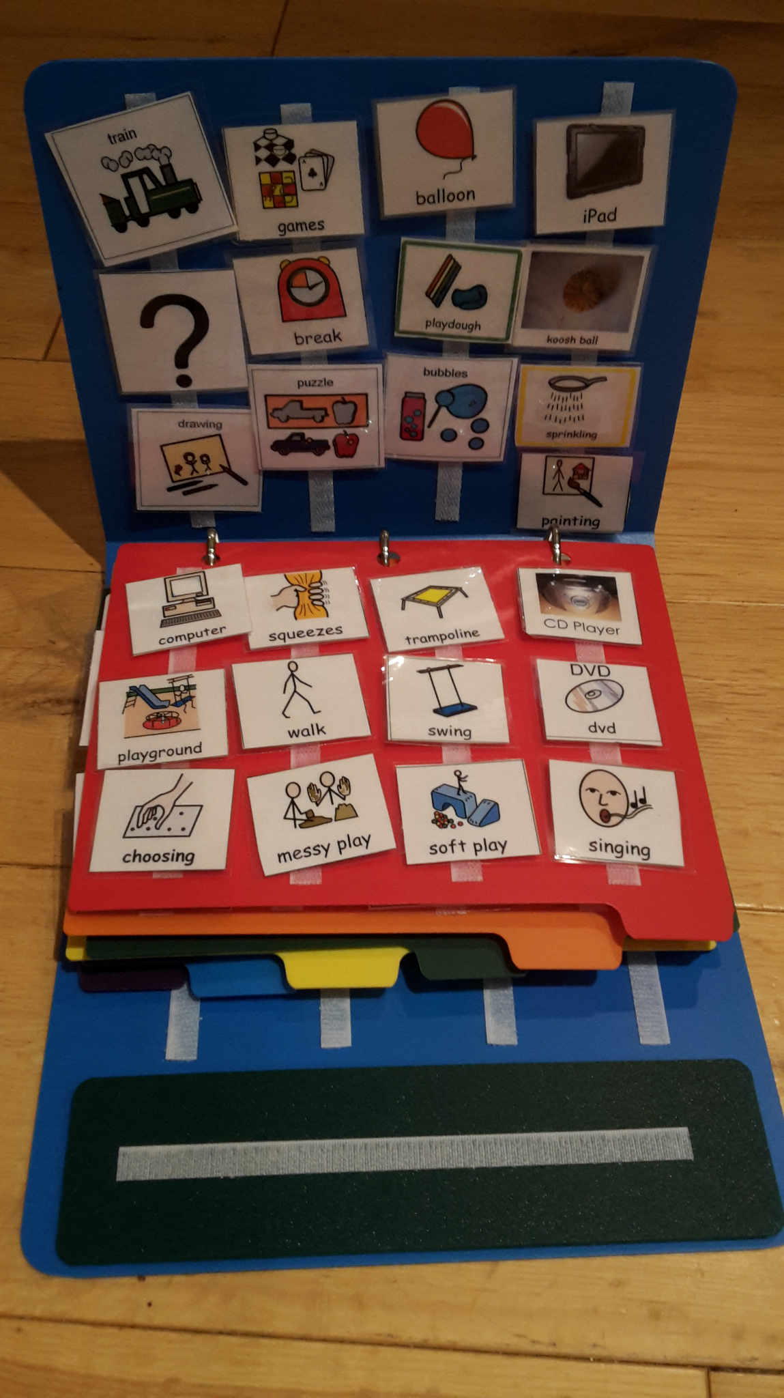
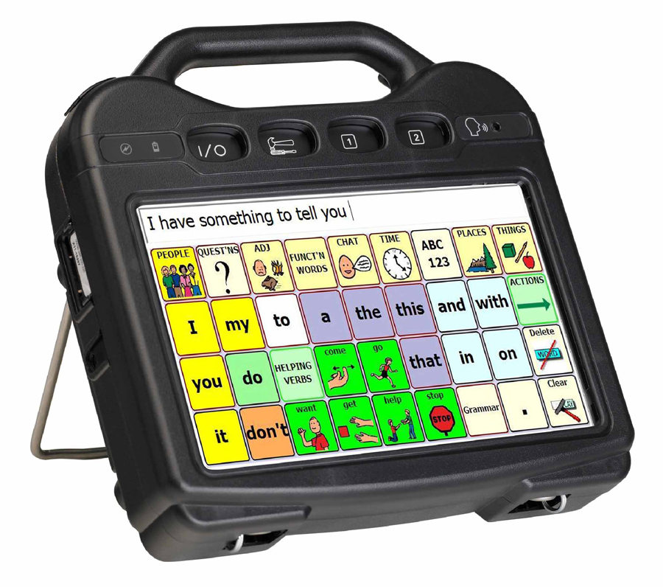
Visual Supports to aid in Communication & Cognitive Processing
Used often with individuals with ASD at home and in schools
Stronger than using words (verbal)
Many different forms such as:
Sign language
Picture Exchange Communication System (PECS)
Communication boards
Augmentative systems

Slide 24
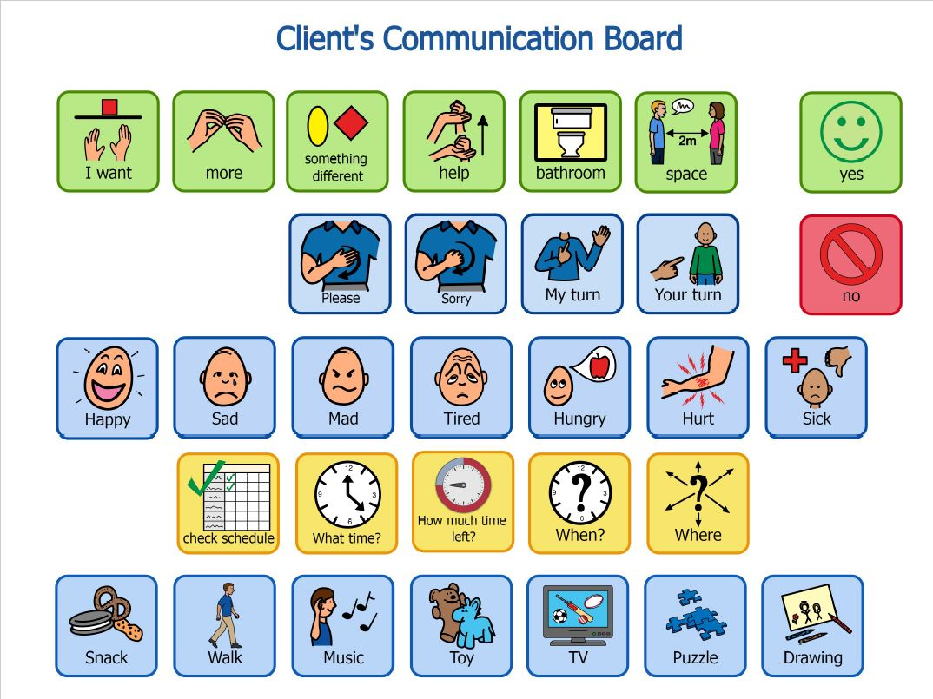
Sample Communication Board

Slide 25
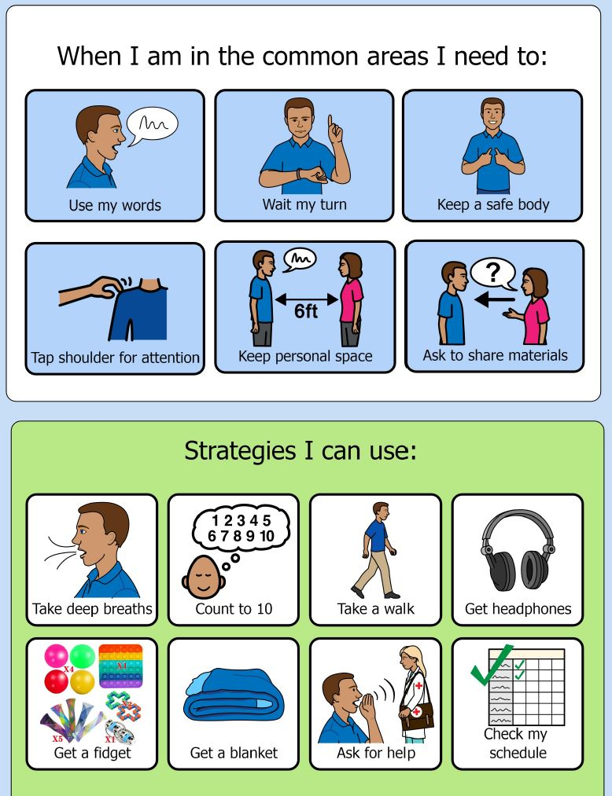
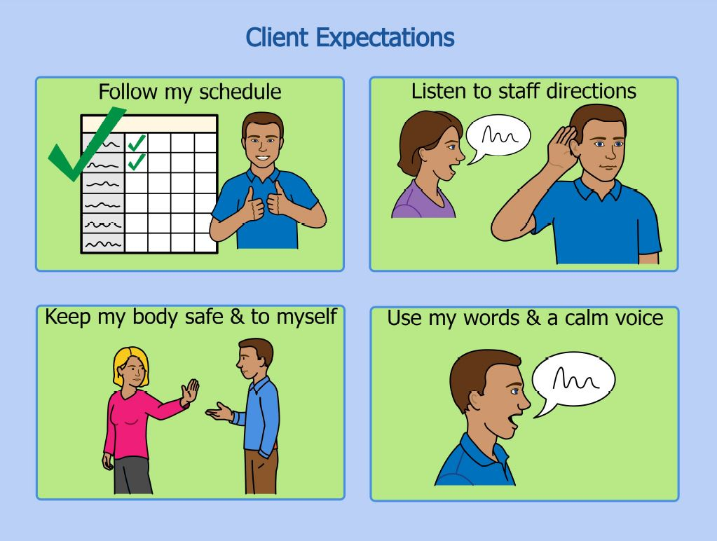
Sample Rules & Strategies Visual

Slide 26
Sensory Abilities
Neurological system does not process sensory input well
Over (hyper) sensitive
Under (hypo) sensitive
If sensitive; may result in unusual or problem behavior to avoid or escape the sensory input
Specific noise, bright lights, sudden sounds
Individual with ASD is responding to their own perception of the environment
May only be able to focus on one sense at a time
95% of individuals with autism have difficulty with “Sensory Modulation”
(Greenspan and Weider, 1998)

Slide 27
Types of Repetitive Behavior or “Stimming”
Motor
Visual
Auditory
Tactile
Taste
Smell
Pacing, twirling, rocking, hand flapping, body rocking
Staring at lights, moving fingers in front of eyes, excessive blinking
Vocal sounds, humming, repetitive vocals
Rubbing self or object, scratching; an aversive to touching certain things
Licking/Putting things in the mouth, eating non-edible items
Smelling Objects, sniffing people

Slide 28
In Summary…
Social Skills Deficits
Communication Challenges
Restricted/Repetitive Patterns of Behavior
Impaired Sensory System
Reactive and Impulsive
May not understand consequences of their actions
7x greater risk for interaction with law enforcement

Slide 29
Be Prepared…
Calls from home vs public will be different
Home may downplay the threat
Public may exaggerate the threat
More calls during periods of transition

Slide 30
Common Interaction Events
Suspicious person (unusual behavior and/or verbalizations)
Unusual behavior (looking into windows, being in dangerous situations)
Shoplifting (obsessive organizing or stealing without awareness)
Domestic disturbance (self-injurious/aggressive behavior, property damage)
Medical assistance
Commission of crime with limited awareness (theft, drug delivery)
Car accident with cargiver incapacitated
Abuse/Endangerment/Misinterpretation of care (bruises to prevent elopement)
Homelessness
Elopement/Wandering behavior
Notes:
*ask Mark about this slide

Slide 31
Elopement/Wandering
Possible triggers:
Sensory need, change to routine, communications &/or social frustration
Ask caregivers:
How does the person communicate?
How will the person respond to LE?
Do they have a tracking device?
What are their areas of interest?
Do they have sensory sensitivities?
Suggest:
Caregivers assist with search and call for the person
Favorite music, TV theme song, etc…

Slide 32
Search and Rescue
Diminished sense of fear = high risk behavior
Search and Secure Waterways!!!
Search and secure other hazardous areas
Tend to follow “lines”
I.e: corn fields, train tracks, telephone poles
Often seek small and tightly enclosed places
I.e: abandoned buildings, vehicles, appliances

Slide 33
Community Policing
Instruct families to help mitigate elopement risk
Secure the home
Electronic GPS Tracking Device
ID bracelets
Swimming lessons
Alert neighbors
Alert law enforcement

Slide 34
Trend: Sex-Based Offenses
Same hormonal drive as others…but limited outlets!
Sexually naive
May say or do something inappropriate
May perpetrate a sexual offense without realizing that they are doing so
Vulnerable to predators who will groom
Sexual abuse, human trafficking etc…
Inappropriate use of social media

Slide 35
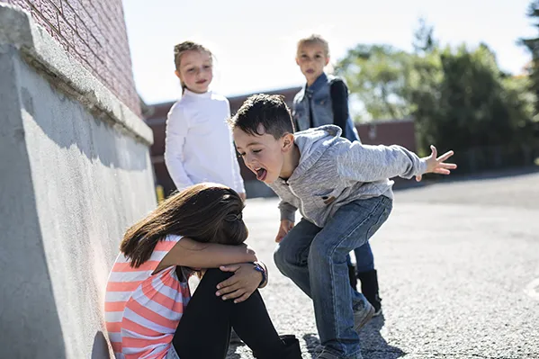
Bullying
Bullies know the triggers
How to provoke without getting caught
Where and when to perpetrate
Person with Autism become angry
May attempt retaliation
Won’t choose the best time/place
Zero tolerance in schools

Slide 36
“Perfect Victims”
According to the US Dept. of Justice…
Crimes against the disabled are underreported…
With a 4-10x greater risk of victimization
Lack of social understanding = targeted
Vulnerable to “false friendships”
Used as “tools” to commit crime
Easily stolen from
Notes:
Talk about current student charged with armed robbery

Slide 37
Managing the Call
Noise and lights to a minimum
Crowds and/or canine partners back
Possible sensory triggers (ex: personal smells)
“Stranger Danger”
Touch could result in “fight or flight”
Prepare for impulsive outbursts…watch behavior!
Always evaluate for injury and illness (ER Issues)
Use blankets for quick removal

Slide 38
Officer Approach
Seek people in the area who might know the individual
How does the individual communicate and respond to stress
Approach slowly and carefully
Maintain some distance
Be calm and appear non-threatening
No quick movements
Do not attempt to alter the person’s activity or take an object away from them unless they are a danger to themselves or others
If a dangerous situation presents itself…revert to your training

Slide 39
Officer Approach… Communication
Use Pictures
Be prepared to repeat yourself
Tell the person what TO DO instead of what NOT to do
May need to resort to written communication
“Bullet point” speech
Limit use of slang, jokes, sarcasm
Do not use threats
Be clear & brief with commands/instructions
Allow processing time
Stay calm
Praise when instructions are followed
Address the individual by name
Do not be afraid to ask the person if they have autism!!

Slide 40
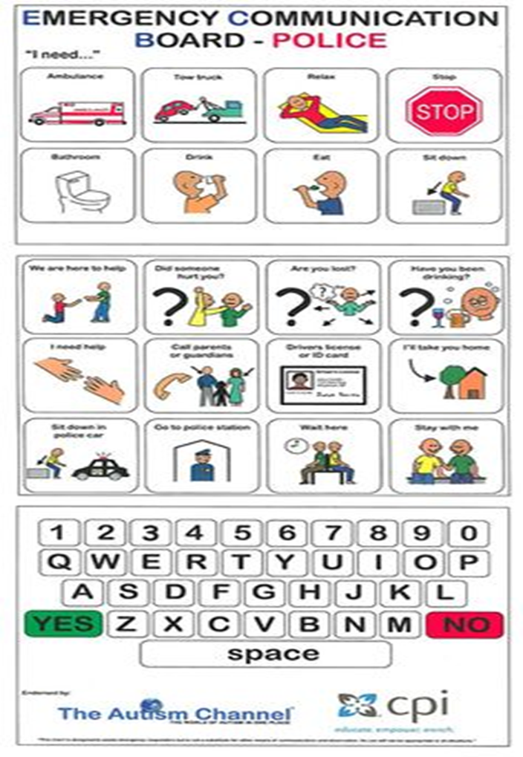
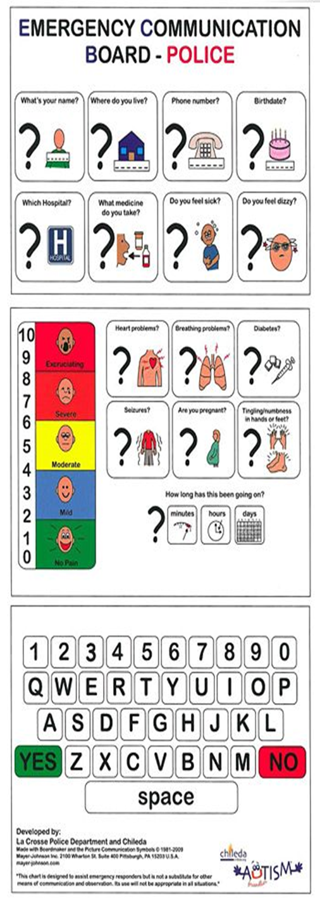
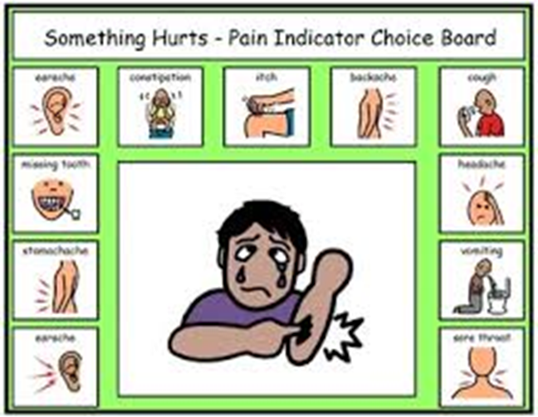

Slide 41
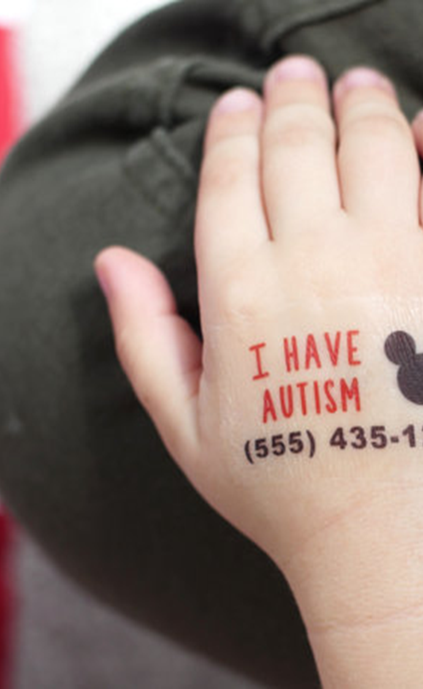
What is the person can’t self-identify?
Ask about or look for ID
ID cards, med alert jewelry, shoe tags, shirt collars, temp tattoos
Check database(s)
Look for autism symbols
Consider possible use of electronic GPS devices/tracking
Phones, watches, tags, etc…
Ambulance/Hospital/Psych Eval

Slide 42
Possible Behaviors When Approached
An individual with autism may…
Speak obsessively/repetitively about a topic
Have poor eye contact, inappropriate facial expressions and appear guilty
Not be able to follow multi-step commands
Not seem aware of the seriousness of the situation
Run away or invade your personal space
Drop to the ground
Engage in self-soothing, repetitive behavior such as body rocking or hand flapping
Be unresponsive or make unusual sounds
Become aggressive or self-injurious

Slide 43
No Matter What You Do the Person’s Behavior May Escalate…
Sensory/communication difficulties result in anxiety & confusion
May lead to a “meltdown”
The individual is feeling threatened and loses all self control
May be feeling physical pain and is unable to communicate
Three Stages in Escalation
Notes:
Julie talks about 3 stages to a meltdown: Rumbling, Rage, & Recovery… Talk to Mark about if I need to use the same terminology

Slide 44
Stage 1: Anxiety & Defensive Behavior
The calm before the storm
A noticeable change in the individual’s behavior
You will sense that the person is getting upset
Watch for:
Increased vocalizations
Pacing
Withdrawal
Non-verbal refusal
Inappropriate language
Low intensity property destruction (e.g., hitting objects, crumpling up paper)
Give personal space and maintain physical distance if possible
Intervention here is key to avoid a meltdown

Slide 45
De-escalation Techniques
Control the environment…remove possible triggers (sensory!)
Allow the individual to have their object or engage in repetitive behaviors unless dangerous
Use simple and concise language
When and Then statements
Can follow up with non-verbal communication (gesture, picture)
Re-direct/distract
Find something that is interesting/distracting to the individual
Offer choices not ultimatums
Time warnings can sometimes help
Do not attempt to force compliance unless there is danger to self or others
Be patient…it could take up to 45 minutes to calm the individual down

Slide 46
Stage 2: Risk Behavior
Behavior that presents a risk to self or others
Person may run away
Engage in self-injurious behavior (head banging, biting self…)
Property destruction
Aggression toward others (hitting, kicking, biting)
No verbal interventions are effective at this time
Use restraint as a last resort for safety of the individual and others

Slide 47
Restraint
Adrenaline surge
Possibility of seizure due to adrenaline
Won’t recognize futility of resistance & will continue to struggle
Pressure on underdeveloped trunk muscles may lead to positional asphyxia…airways collapse!
May not be able to communicate that they cannot breathe
May use sign language to communicate, keep that in mind
Side holds recommended
Be aware of pressure
Continue to monitor for possible injury

Slide 48
Stage 3: Tension Reduction
Individual is back under emotional and physical control
Behaviors they may exhibit:
Crying, apologizing, regulated breathing, falling asleep
Attempt to re-establish communication

Slide 49
If you must take a person with autism into custody…
Extremely vulnerable with jailhouse population… SEGREGATE
Seek assistance from a professional familiar with this disability
Be aware of “Positive Response Bias”
Prosecutors, attorneys, advocates all need information on how to communicate with the individual

Slide 50
Great Resource
Victims with Disabilities: The Forensic Interview…
Techniques for Interviewing Victims with Communication and/or Cognitive Disabilities
Published by the U.S. Department of Justice
www.ovc.gov/publications/infores/pdftxt/VictimsGuideBook.pdf

Slide 51
Preventing Problematic Interactions with the autism community!
Dispatch telecommunicators need info about autism
Get critical information from caregivers
Communication
Stress response
Sensory issues
Unusual behavior
Medical diagnoses

Slide 52
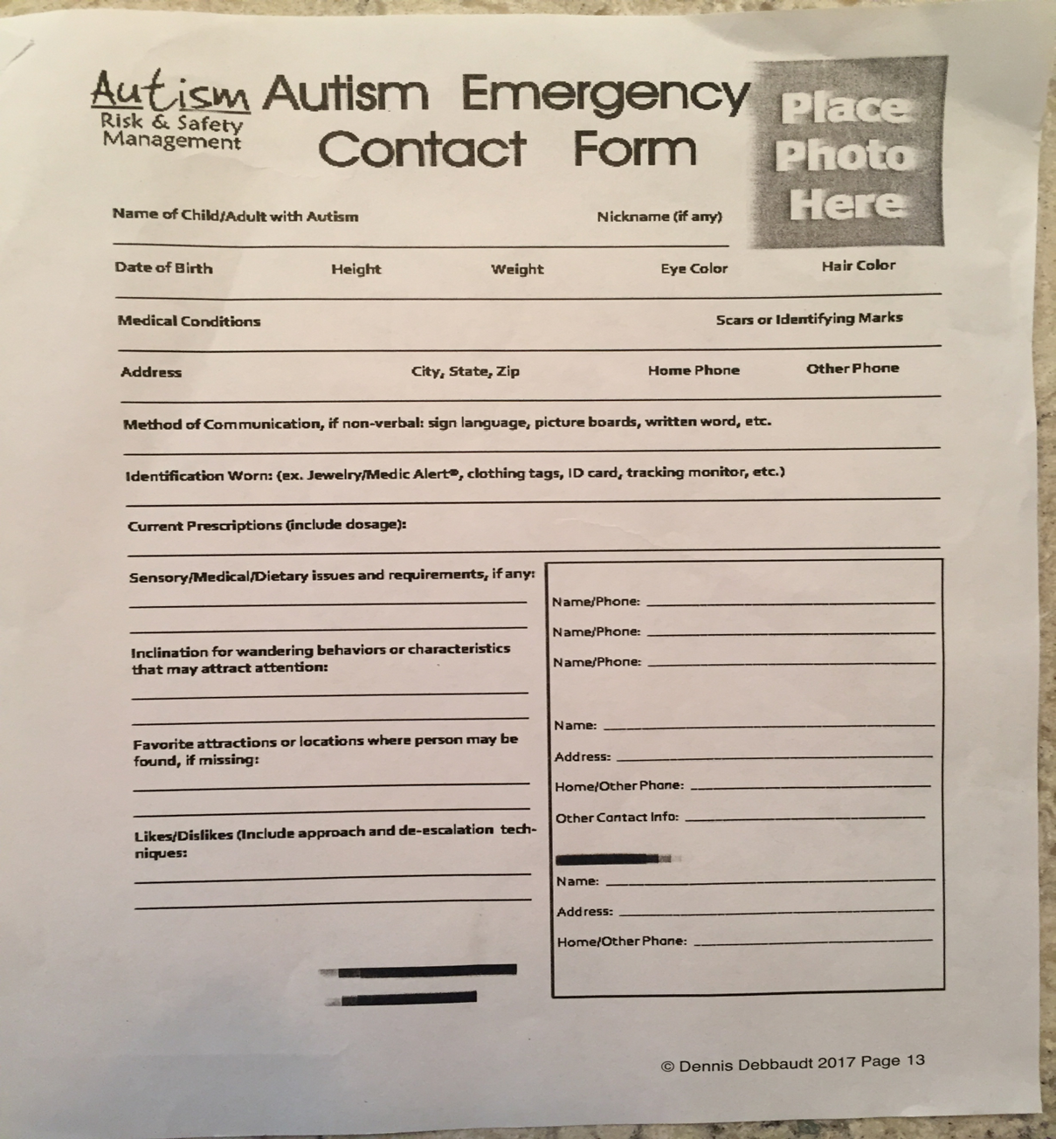
Autism Emergency Contact Form
www.autismriskmanagement.com

Slide 53
Community Policing Resources
Screening, Assessment and Support Services (SASS) for Children and Adolescents-Call CARES hotline at 1-800-345-9049. (mental health screening and referrals for youth with public aid)
Illinois Dept. of Human Services: Independent Service Coordination (ISC) Developmental Disability Services - provide information, assessment & referral regarding developmental disabilities. www.dhs.state.il.us (PUNS)
Early Childhood Technical Assistance (ECTA)- If the child in question is not yet 3 years old contact ECTA for assistance with diagnostics and Early Intervention services. www.etcacenter.org/contact/619coord.asp or call 1-800-323-4769
Local Public School System-If the child is not yet old enough for kindergarten families can contact their local school system for assistance with diagnostics. www.etcacenter.org/contact/619coord.asp or call 1-800-323-4769

Slide 54
Illinois Secretary of State Resources
ID Card Application for citizens with developmental disabilities
www.cyberdriveillinois/publications/pdf_publications/dsd_x164.pdf
Emergency Contact Database: free, anyone with DL or state ID can enter info, contact persons, medical issues, drug allergies can be added and only LE can access this info.
www.cyberdriveillinois.com

Slide 55
General Resources
Autism Risk Management: Dennis Debbaudt’s website. Mr. Debbaudt is a nationally-renowned speaker and trainer who has written a number of publications on the issue of law enforcement training in the field of autism.
www.autismriskmanagement.com
National Center for Missing and Exploited Children (report lost children, education for LE): 1-800-the lost
A Child is Missing (federally funded alert system): Achildismissing.org
Tattoos with a Purpose: call 1-800-357-1521 or www.tattooswithapurpose.com
National Autism Association: www.nationalautismassociation.org

Slide 56
One Road ID Personalized, Engraved SHoe ID tag
Two Door/Window Alarms
Five Laminated Adhesive Stop Sign Visual Prompts for doors & windows
Two safety alert window clings for car or home windows
One red safety alert wristband
One child ID Kit from the National Center for MIssing & Exploited Children
Educational materials and tools including NAA’s BeREDy Booklet

Slide 58
References
American Psychiatric Association: Diagnostic Manual of Mental Disorders, Fifth Edition, Text Revision. Washington, DC, American Psychiatric Association, 2013
American Psychiatric Association: Diagnostic Manual of Mental Disorders, Fifth Edition. Washington, DC, American Psychiatric Association, 2000
Autism Speaks: https://www.autismspeaks.org/
Center for Disease Control and Prevention: https://www.cdc.gov/
Crisis Prevention Institute Instructors Manual
Curry, K., Posluszny, M. & Kraska, S. (1993). “Training Criminal Justice Personnel to Recognize Offenders with Disabilities”. Office of Special Education and Rehabilitative Services News in Print.
Davis, B. & Goldband Schunick, W. (2002) Dangerous Encounters: Avoiding Perilous Situations with Autism. London: Jessica Kingsley Publishers
Debbaut, D. and Rothman, D. (2001) Contact with Individuals with Autism: Effective Resolutions. FBI Law Enforcement Bulletin, 7,4, 20-24.

Slide 59
References
Greenspan, S. & Weider, S., (1998). The Child with Special Needs: Encouraging Intellectual and Emotional Growth. DeCapo Press.
Myles, B. & Hubbard, A. (2005) The Cycle of Tantrums, Rage, and Meltdowns in Children and Youth with Asperger Syndrome, High-Functioning Autism and Related Disabilities. Presented at the Inclusive and Supportive Education Congress-2005.
National Institute of Neurological Disorders and Stroke: https://www.ninds.nih.gov/
National Institute on Alcohol Abuse and Alcoholism: https://www.niaaa.nih.gov/
Perske, Robert (1991) Unequal Justice? What Can Happen When Persons With Retardation or Other Developmental Disabilities Encounter the Criminal Justice System. Nashville, TN: Abingdon Press
Victimization of Individuals with Disabilities (1999). US Department of Justice: National Victim Assistance Academy Chapter 14.
Winslow, Dr. Frances E. “Socializing The Developmentally Disabled to Public Safety Officers”. Irvine, California: Irvine Police Department

Slide 60
THANKS!
SNHinkle@ssdmo.org
314-989-7860
ssdmo.org

