Slide 1
Working with Older Adults
Mark Benson, LCPC
markbensonlcpc@gmail.com
(309) 212-4192

Slide 2
Overview
Review Bio/psycho/social changes in aging
Address mental health issues with older adults
Identify and address cognitive impairments
Substance use and misuse
Elder abuse and self-neglect
Applying this to CIT

Slide 3
This Generation
75 y/o ~ born in 1946
85 y/o ~ born in 1936
WHAT have they seen and lived through?
WHERE are they now?

Slide 4
Aging: Physical
Graying/loss of hair
Skin– thinning, dryness, pigment changes
Vision– decreased acuity, cataracts, glaucoma, macular degeneration
Sleeping Patterns- more difficulty falling and staying asleep
Brain shrinks causes some memory impairment
Bone loss, decrease in muscle mass, joint problems
Vascular changes– thicker heart muscle and artery walls
Metabolism slows- decrease in energy levels
Sensory changes- hearing, smell, touch, taste

Slide 5
Aging: Psychological
Erik Erickson’s Psychosocial Stages of Development
Generativity vs Stagnation
During the ages of 40 to 65 (generally speaking), psychologically healthy individuals seek to “make their mark” and contribute willingly to society to increase our sense of community. This way, our actions leave an impact on those who come after.

Slide 6
Aging: Psychological
Erik Erickson’s Psychosocial Stages of Development
Integrity vs Despair
Frequently after age 65, people recognize they are reaching the end of their life and look back on their past experiences to judge whether they accomplished their life goals, and if their lives had any meaning or purpose.
(https://www.simplypsychology.org/Erik-Erikson.html)

Slide 7
Most Common Concerns of Older Adults
Depression
Agitation
Thought disturbance /Perceptions
Alzheimer’s Disease /Dementia
Substance Abuse/Medication Misuse

Slide 8
Depression
Often missed or untreated
  Approximately 10% of people over 65 are treated for depression
Symptoms are sometimes dismissed
as crankiness, grumpiness or part
of the normal aging process
Mood changes and other
signs of depression can be caused
by medications

Slide 9
Depression: Triggers
Physical Illness
Dementia
Bereavement/Grief
Environmental/ Care giving
Stress and Conflict with Adult Children
Substance Abuse

Slide 10
Older Adult Suicide Facts
12.5% of the population is over 65. Account for 18% of all suicides
The suicide rate for adults >75 is 3X higher
75% of older adults who complete suicide saw their primary physician within the last month
White men over 55- highest rate of suicide
Make less attempts, but are more likely to die from an attempt

Slide 11
Suicide: Risk Factors
  Experienced the death of a loved one
  Illness
  Isolation
  Role change
  Divorce/Widowed
  Financial
  Family history of suicide

Slide 12
Agitation
Confused with anxiety but commonly seen in anxious persons
An inappropriate verbal, vocal or motor activity, not an obvious expression of need –repetition
Not a diagnosis but a group of symptoms

Slide 13
Signs of Agitation
Extreme Irritability
Anger
Fidgeting
Racing Thoughts
Restlessness
Pacing
Hand-wringing
Nail-biting
Verbal Outburst
Pulling at clothes or hair
Taking clothes off
Picking at Skin

Slide 14
What Exacerbates Agitation?
Fatigue
Over stimulation: music, loud noise
Crowds
Unfamiliar places
Co-Morbid illnesses
Demands above the person’s abilities
Medication misuse
Traumatic Events
Anxiety Disorders

Slide 15
Content of Thought
Disturbances of Perception
Hallucinations: Can impact 15%-50% of adults with dementia
Delusions –False fixed beliefs, often negative and persecutory in nature, especially in Dementia (20-75%)
Five Types:
  People are stealing items (18-43%)
  Misidentifications (This house is not mine) Spouse, family or familiar person is an imposter
  Abandonment (3-18%)
  Infidelity (1-9%)

Slide 16
Medication Misuse
Older adults consume an average 2-6 prescription medications per day and 1-3 OTC medications per day
About ½ of drugs prescribed for older adults include some form of sedative
Misuse can be intentional or unintentional
  Multiple doctors
  Confusion
  Cognitive Impairments
  Use of alcohol or other drugs
  Financial difficulties
  SAMSHA

Slide 17
Substance Use
As we age the body’s ability to absorb and dispose of medications, alcohol and other drugs changes
Substance use and medication misuse: Often mistaken for dementia, depression or other problems common to older adults
Belief taking more medications / vitamins / supplements will improve quality of life.
Use of alcohol in older adults may increase the likelihood of drug interactions and raise blood alcohol levels more quickly

Slide 18
Substance Use
CDC: Adults 65 and older are more likely to engage in binge drinking than younger adults
Older Adults experience effects of alcohol more quickly
Increase risk for falls or unintentional injuries
Estimated 17% of older adults are affected by alcohol and prescription drug misuse and overuse

Slide 19
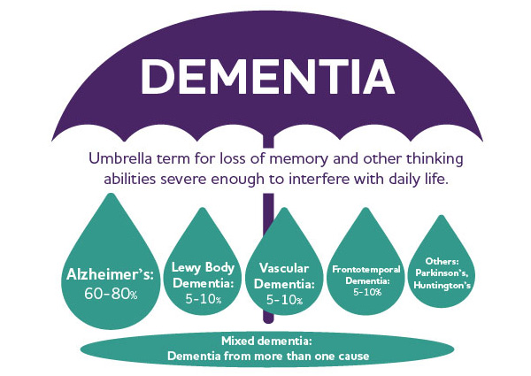

Slide 20
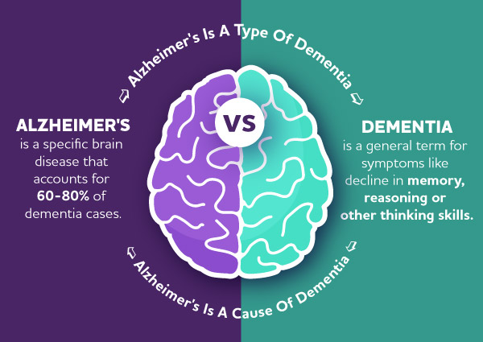

Slide 21
Early Stage Alzheimer’s
Difficulty with tasks such as balancing a checkbook or making dinner
Difficulty learning new tasks
Slower reaction time when driving or making decisions
Aphasia (difficulty finding words to use in conversation)
Short term memory loss
Increased irritability, anxiety, or feelings of depression
Social withdrawal
Often aware of these changes

Slide 22
Moderate Stage Alzheimer’s
Significant personality changes, such as being argumentative, impulsive, angry
Resistant to, or combative with, physical care provided by others
Short-term and long-term memory loss
Increased difficulty in communicating with others
Potential for wandering away from home
Very poor judgement and lack of decisional capacity
Possible incontinence
Possible paranoia, hallucinations, or delusions

Slide 23
End Stage Alzheimer’s
Decreased ability to interact with others
Diminished ability to recognize people
Flat affect
Extremely poor motor function and spatial awareness
Limited or no speaking ability
Difficulty with eating, even with assistance
Apparent withdrawal from surroundings
Incontinence
Final stage: body begins to shut down as the brain loses the ability to regulate organ systems

Slide 24
Review
Alzheimer’s Disease is progressive
Dementia is an umbrella term; there are many types of dementia including Alzheimer’s Disease
There are no known causes or cures; only medications to help minimize the symptoms
Cognitive loss includes changes to memory, reasoning, communication, personality, behavior, judgments and decision making
Easily becoming lost and wandering are common behaviors with adults with dementia

Slide 25
Wandering
6 in 10 adults with dementia will wander
An adult with dementia may not remember his or her name, address.
May become disoriented in familiar places

Slide 26
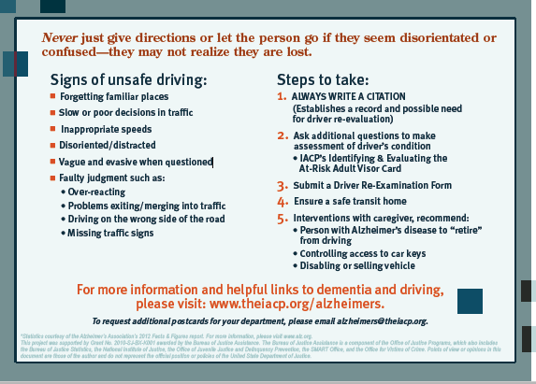
Encountering an Older Driver

Slide 27
Silver Search
1/1/2016- Illinois passed legislation to create a coordinated effort to bring education, awareness, and resources to assist in safely returning individuals with dementia that go missing
Goal is to quickly disseminate information about a missing or endangered person to the public
Silversearchillinois.org

Slide 28
Endangered Mission Person Advisory Criteria
Missing person is under unexplained or suspicious circumstances
Person is believed to be in danger due to age, health, mental or physical disability, environment, weather conditions or in the company of a potentially dangerous person of some other factor that may expose the person to possible harm or injury
Does not meet the criteria for an AMBER alert

Slide 29
Validation
Don’t confirm or deny frame of reality
Remember behaviors may reflect a need; trying to discover this need may be very helpful in how one chooses to validate
Example: a demand to go home may be a reference to a desire to feel safe and secure rather than a physical location
Validate by repeating a concern, and when possible, express personal agreement with the concern to showcase empathy

Slide 30
Redirection
Redirection to a conversation with a similar topic
Allows for a natural transition
May need to gradually steer the conversation towards a new subject
Often helpful to have some redirection ideas planned in advance
Provide validation of feelings (sad, anxious, mad)
Reassurance before redirection- shows understanding of the concerns, prompts cooperation

Slide 31
Compassion/Empathy
Treat as you would want your parent to be treated
Allows the person to feel respected/validated
Increases feelings of safety
Increases hope/optimism

Slide 32
Interaction Tips
Make eye contact
Address the person by name
Use short, simple words and sentences
Monitor body language and non-verbal cues
Stay calm
Don’t take behaviors personally
Never argue or insist
Be positive, focus on what they can do, not what they can’t
If ambulatory, walk to reduce adrenaline
Seniors may need more time to process information

Slide 33
Interaction Tips
Limit distractions/overstimulation
Use humor when appropriate
Make sure a neighbor or friend are aware of the situation
Focus on safety and solutions
Use touch and hugs to connect emotionally
Encourage nonverbal communication, such as body language (pointing, thumbs up, head nodding, etc.)
Be respectful, in every situation

Slide 34
Interaction Tips
Assume the older adult is cognitively intact unless you are given clear reason to question this
Gain trust . You don’t know their history with law enforcement
Alterations in the mental status often due to physical illness
Look for changes in appearance & behavior, speech, general motor activity, mood, posture/gait
Obtain input from someone who knows the senior’s normal baseline

Slide 35
Interaction Tips
Look for medical alert bracelets
Talk directly to the senior- Eye contact
Don’t talk down to them as if they were a child
Acknowledge their frustration
DON’T argue reality
Repeat, repeat and repeat
Limit open-ended and memory questions
Keep the atmosphere calm
Move the senior to an area of less stimulation

Slide 36
Interaction Tips
Remember – persons with Dementia / Mental Health impairments are easily abused, exploited and taken advantage of.
Multiple calls concerning the same victim may not all be unfounded….look for hidden clues
    Minimizing
    Excuses
    Environmental concerns
    Abusive behaviors toward the victim by friends/ family members in your presence

Slide 37
Adult Protective Services Act
Adult Protective Services Act 320 ILCS 20/1 et seq.:
  Allows Illinois Department on Aging to investigate abuse of seniors or adult with a confirmed or suspected disability in a community setting.
  Alleged abuse, neglect or financial exploitation of persons > 60 years old and adults with disabilities
  Promotes investigation, intervention and follow-up services
  Reporters of abuse, neglect and exploitation are immune from criminal or civil liability or professional disciplinary action
  Reporters are anonymous (except with the written permission of the reporter or by order of a court)

Slide 38
Adult Protective Services
APS
Social Services Program with the goals to:
Investigate reports of alleged abuse
Intervene to prevent further mistreatment
Allow a person to remain independent to the maximum degree possible.
APS Goal: Keep the person safe and independent in their home environment
APS 24 Hour Hotline: 1-866-800-1409

Slide 39
APS: Process
Intake:
Contact APS 24/7 to provide intake information
Assessment:
Initiated within 24 hours or up to 7days
30 days to complete the assessment
Follow up:
Case can be kept open for up to 15 months
Additional time can be added
APS 24 Hour Hotline: 1-866-800-1409

Slide 40
Power of Attorney and Guardianship
Power of Attorney broadly refers to one's authority to act and make decisions on behalf of another person in all or specified healthcare, financial or legal matters. The power of attorney can be changed at anytime as long as the person retains some capacity to understand.
Guardianship is a court action appointing someone to make decisions for you when you become incapable of making your own decisions due to an illness or when an incapacity endangers your health or safety

Slide 41
Abuse: Definitions
Physical abuse is the use of force to threaten or physically injure a vulnerable adult
Emotional abuse is any form of verbal attacks, threats, rejection, isolation, or belittling acts that cause or could cause mental anguish, pain or distress to a vulnerable adult
Sexual abuse is any sexual contact that is forced, tricked, threatened, or otherwise coerced to a vulnerable adult
Exploitation is any form of theft, fraud, misuse or neglect of authority, and use of “undue influence” as a lever to gain control over a vulnerable person’s money or property

Slide 42
Signs of Abuse
  Bruises, slap marks, pressure marks
  Burns or blisters
  Unexplained sexually transmitted disease
  Withdrawal- unexplained change in alertness
  Sudden change in finances and accounts, altered wills and trusts, unusual bank withdrawals, checks written as “loans” or “gifts”, and loss of property
  Bedsores, need for medical or dental care, unclean clothing, poor hygiene, overgrown hair and nails, unusual weight loss
  Be aware of statements that minimize potential for harm or “explain away” an apparent injury or impairment

Slide 43
Abuse Definitions
Neglect: Failure or refusal to provide for a vulnerable adult’s safety, physical, or emotional needs. Both Passive and Willful
Willful Deprivation: Willfully denying a vulnerable adult medication, medical care, food, shelter or other physical assistance
Confinement: Restraining or isolating a vulnerable adult for other than for medically appropriate reasons

Slide 44
Other Concerns
Self-neglect:
Behavior of a Vulnerable Older Adult or Vulnerable Person with a Disability
Who is not able to make appropriate decisions or understand consequences for their own actions
Behavior substantially threatens own health and safety including the inability to provide for own basic needs and personal hygiene, which may lead to harm or endangerment

Slide 45
APS Providers for Area 5
Family Service Senior Resources of Champaign County
405 S. State Street
Champaign, IL 61820
217-352-5100
Counties Served: Champaign and Piatt
Care Horizon
304 North Maple
Urbana, IL 61802
Care Coordination: Champaign, DeWitt, Douglas and Piatt
217-384-3360

Slide 46
APS Providers for Area 9
Swan- Stopping Woman Abuse Now
115 S. Maple
Salem, IL 62881
618-740-0898
Counties Served: Fayette, Effingham, Marion, Clay and Jefferson
Care Coordination: Effingham City/County Committee on Aging- Senior Services of Fayette County
618-283-4122

Slide 47
APS Providers for Area 10
SWAN (Stopping Woman Abuse Now)
1114 S. West Street
Olney, IL 62450
618-392-3556
Counties Served: Jasper, Crawford, Richland, Lawrence, Wayne, Edwards, Wabash, Hamilton and White
Care Coordination: Effingham City/County Committee on Aging- Senior Services of Clay County.
618-662-7304

Slide 48
Final Thoughts
Don’t judge
All people want to retain their dignity, even when their bodies and minds are failing
Be respectful
Everyone has a story
Acknowledge changes in the lives of seniors
    People around them
    Their role in life and society
    Sensory changes
    Loss of independence and choice
    Financial

