Slide 1
De-escalation of Crisis Situations
Jeremy Romo
St. Louis County Police Department
Notes:
Introduce myself: Raised in IL – Attended WIU
St. Louis County Police for 15 years: Patrol, Tactical Operations, Precinct Supervisor and CIT Coordinator.
explain how I ended up the CIT Coordinator – Full time position
Talk about Geno and his book Compliant Surrender and
Geno and I have taken similar path through the department. Including path to negotiator (asked by Frisz):
Build on Geno’s presentation by talking about how it used to be done and how there has been a culture change Geno’s day to my days in Tact. Philosophy change
other educator’s contributions to my qualifications and the CIT Program (Give credit where credit is due)
Teach you the right way to communicate and illustrate that by giving you examples of how I personally have communicated the wrong way.
My take on CIT Program – Not a replacement for safety
Strength is in the partnership – Powell Shooting

Slide 2
Objectives
Describe how crisis intervention techniques can assist with conflict resolution
Explain why training in communication and active listening are an important part of a law enforcement officers professional development
Explain the concept of serve and protect
Describe two types of officers and explain the characteristics of both
Define confidence and professionalism
Explain the difference between maturity and arrogance and how both can affect a satisfactory resolution to a crisis situation

Slide 3
Objectives
Define crisis and explain what occurs to an individual when they are in crisis
Recognize an individual who is in crisis and describe how to de-escalate that individual
Explain the importance of time in crisis intervention
List emotional and physical barriers that can affect a law enforcement officers ability to de-escalate a crisis situation
Explain the different types of barricaded situations and describe the appropriate response for each
List and describe the different types of Active Listening Skills

Slide 4
Objectives
Explain different de-escalation techniques
Explain the indicators that a law enforcement officer is making progress when de-escalating a crisis situation.
Define the concept of officer created jeopardy and describe how to avoid it.

Slide 5
Why is this training important?
Why is it important that we learn to communicate with individuals in mental health crisis?
Increases officer safety
Separate people who are criminals from people who need services
Gets people connected to those services
Reduce stigma
Notes:
When we lay hands on someone we run the risk of getting injured
Got into this profession to help people.
Connect Mentally ill, homeless and substance use issues to services
Let’s us get back to locking up bad guys
Tully Video from MHFA (STIGMA)
40% of police work involves someone in crisis or people experiencing mental illness
Mentally ill or more likely to become victims of a violence than suspect. 11 times more likely
What are the largest Psychiatric facilities in the U.S. (Rikers Island, L.A. County Jail, Cook County Jail)
Arrests of mentally ill people are usually for minor offenses that if you address underlying problem the criminal aspect goes away.
This training is important because we are a 24/7 operations and they are going to call us for help.
The professionals call us when they can’t handle the problem

Slide 6
Why is communication important?
How an officer communicates, both verbally and non-verbally, with an individual experiencing a mental health challenge or acute episode of mental illness, will often determine how the interaction between the individual and the officer will go.
When dealing with individual experiencing a mental health challenge or acute episode of mental illness, it is crucial for the officer to remember that having a mental illness is not a crime, it is a medical condition, and in most cases, when dealing with an EDP or a person experiencing an acute mental illness, no crime has been committed. Therefore, it is critical that an officer treat each person they encounter with dignity, respect, understanding, and compassion.

Slide 7
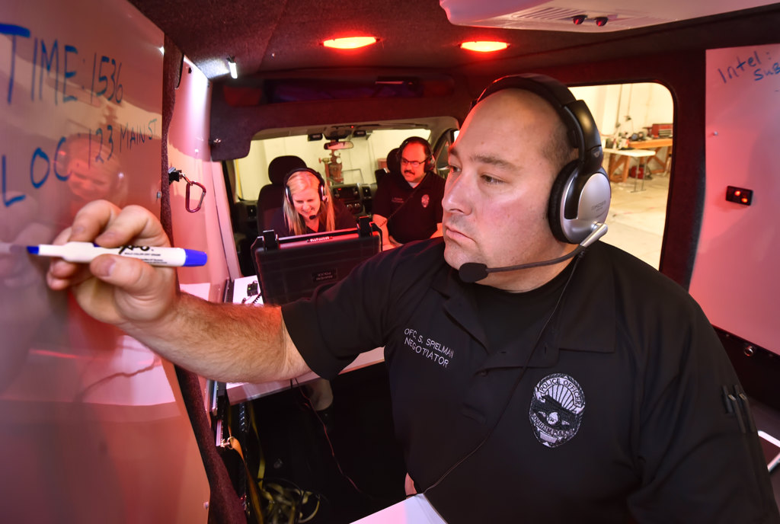
Who uses Crisis Communication?
Patrol officers who respond to all types of calls.
Detectives who conduct investigations and interviews
Crisis Intervention Team Officers
First Responders to barricade situations
Advanced law enforcement negotiators

Slide 8
Some Facts about People with Mental Illness
  Biological illness like heart disease or cancer
  Nobody “chooses” to develop a mental illness
  There is no cure, but many people stabilize to live full, productive lives
  Medications help, but they are not perfect and there can be episodes or side-effects
Adapted from Seattle Police Department

Slide 9
Traditional Law Enforcement Communication
What did we learn in the Police academy about communication?
Traditional Police Mindset
What are the benefits of CIT and Crisis Intervention?
Notes:
Why are we here? What did they teach us in the academy about communication? Ask, tell, Make.
Traditional police mindset is counter to crisis intervention
CIT training leads to less use of force and less injury to officers and consumers
(police presentation vs. public presentation)
CIT lead to less 10-40’s
Less time on calls
Consumers getting connected to services and off our plates
Ask students at SB what most important tool for a law enforcement officer is.
Young cops how quick they can get a guy in custody vs. talk a guy into custody.

Slide 10
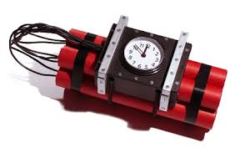
Traditional Law Enforcement Response
Action Imperative
Where do we get pressure in law enforcement to resolve the situation quickly?
Ticking Time Bomb Example
Notes:
Get it done and move on to the next call.
Handle your beat, handle your calls. Worked next to a guy that started at 10:30 and would take a warrant arrest every night.
Businesses need to open, Bridges open, get to work.
Describe Geno’s ticking time bomb example
Bridge Example and neighborhood blocked. Supervisors, officers, neighborhood, businesses etc.
These are situations where you have to slow down.
Call on your training and experience

Slide 11
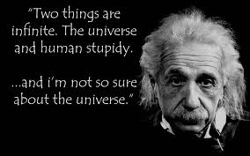
Training
Ignorance
Stupidity
Notes:
Ignorance – lack of knowledge or info
Stupidity – Behavior that shows a lack of good sense or judgment
Ignorance can be fixed with training and experience.
What does traditional Police training look like? What classes fill up?

Slide 12
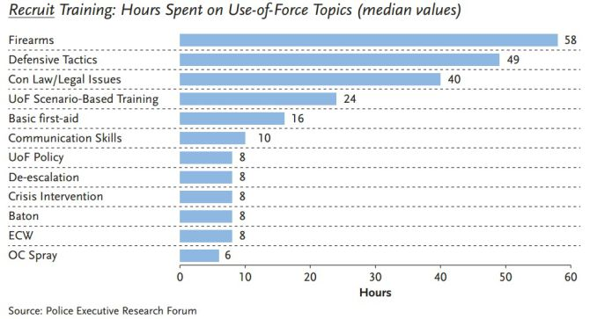
Hours Spent on Training
Notes:
Police Executive Research Forum Survey of 280 Law Enforcement Agencies in Spring of 2015

Slide 13
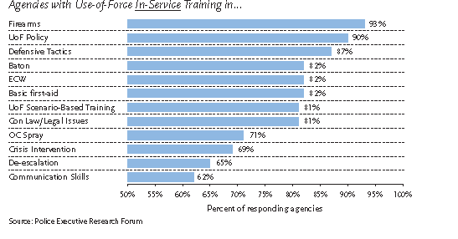
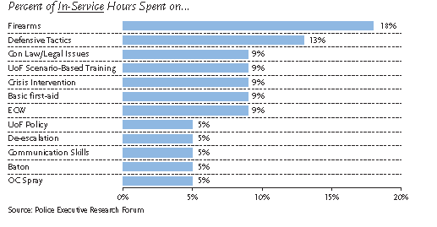

Slide 14
Crisis Recognition And Response
Crisis Intervention
A process to assist individuals in finding safe and productive outcomes to unsettling events
Adapted from Police Training Institute
University of Illinois

Slide 15
EMOTIONALITY
NORMAL FUNCTIONING LEVEL
RATIONALITY
Notes:
Normal Functioning Level is not a straight line, but is wavy = emotional state is fluid.
Crisis state is a state of disequilibrium.
Take your time. Be deliberate and methodical. Allow time to pass.
Time alone will assist in defusing emotions.
Don't "push"/"force" surrender.
Subject may simply not be ready.
Avoid "Action Imperative".
Example of putting it on myself and talking about how I make bad decisions when I am emotional.

Slide 16
Definition of Behavioral Crisis
An episode of mental and/or emotional distress that is creating instability or danger and is considered disruptive by the community, friends, family or the person him/herself
Adapted from the Seattle Police Department

Slide 17
Characteristics of Crisis
Disruption of one’s general state of psychological balance
Usual coping mechanisms have failed
Distress, impairment or dysfunction.
Distress
Impairment
Dysfunction
Gerald Caplan, MD
Notes:
Distress - Everyone
Impairment - Some
Dysfunction - Few

Slide 18
Crisis State
A precipitating event has recently occurred and the subject’s normal coping mechanisms have not worked to resolve the situation
The subject is acting and responding from an intense emotional level rather than a rational/thinking level, in response to a highly stressful situation
Notes:
27

Slide 19
Crisis State
The situation is perceived to be a threat to the emotional, psychological and physical needs of the subject
Physiological changes are brought about.
Notes:
What are some of those physiological changes?
When we are confronted by or faced with a subject(s) in a crisis state then we are also put into a state of crisis.
We will also experience the same physiological changes.
Increased heart rate
Tunnel vision
Adrenaline dump
Impaired reasoning
Loss of fine motor skills
Fear or anxiety
Fear is not a bad thing if you can control it and keep a survival mindset.
The difference between us and the rest of society is we control our fear.
Miami Dade Example
When we are confronted with person in crisis state we often also go into crisis state (All eyes are on you as CIT/Negotiator)
How you combat these changes is dictated by your training and experience

Slide 20
Understanding Crisis
Confronted with a situation perceived to be a threat to one’s emotional, psychological and/or physical needs.
Affects the way a person thinks, feels and behaves.
Emotions (not reason) are controlling behavior.
Normal coping skills have failed
Precipitating event within the last 24-48 hours
Real or perceived loss
Notes:
How is the situation perceived to them.
If it is a crisis to them it must be a crisis to you.
This can be difficult to do especially for cops
Difficult with juveniles.

Slide 21
Crisis Recognition And Response
Mental
Illness
Substance
Abuse
Emotionally
Distressed
Person
Career
Financial
Relationship
Medical
Condition
Situational
Stress
Adapted from Nassau County, NY Police Department
Notes:
What can cause a person to become emotionally distressed?
Medical Conditions:
Persons with Intellectual and Development Disabilities
Autism spectrum disorder
Cerebral palsy
Epilepsy
Developmental delay
May result in difficulties in communication, adaptive living skills, self-direction, mobility.
Persons with Physical Disabilities
Deaf/hard of hearing
Blind/low vision
Muscular Dystrophy
Multiple Sclerosis
Stroke
Alzheimer’s
Huntington’s Disease
Head/spinal cord injury
May make it difficult for people to hear, comprehend and follow directions – and to respond back to you.

Slide 22

Crisis Recognition And Response
Persons with disabilities may exhibit same behaviors as Emotionally disturbed persons
  Don’t always assume it’s mental illness
  Could be one of many factors – or a combination of several
  Focus on subject’s behavior
Notes:
Call on Jeff Thompson

Slide 23
Crisis Recognition And Response
Another Approach – Ask!
  Ask the person …
    Are you on medication?
    Do you normally see a doctor?
  Ask family members or friends nearby …
    Does the person have a mental health condition?
  Ask Dispatch
    Get more information, ask follow-up questions
Notes:
Call on Jeff Thompson

Slide 24
Common Signs of Agitation With Someone In Mental Health Crisis
Raised voice
High-pitched voice
Rapid speech
Pacing
Excessive sweating
Excessive hand gestures
Fidgeting
Shaking
Balled fists
Erratic movements
Aggressive posture
Verbally abusive

Slide 25
Other Characteristics of Individuals in Crisis
May feel like a failure
May have little or no regard for authority
May be emotionally exhausted
May have trouble focusing
May have trouble following through with decisions
Have a difficult time forecasting consequences
Often cannot see positive outcome
Can be impulsive
Impulse control can be affected by use of alcohol and drugs
Notes:
TRANSITION
Time is an important concept to understand when dealing with someone in crisis.
How it affects the situation

Slide 26
Individuals in Crisis Construct Barriers
Emotional Barriers
Anger, pride, depression, anxiety, frustration, disappointment, sadness
Physical Barriers
Buildings or structures, space, distance, elevation, weapon, any object that impedes progress
Other potential barriers
Language, Culture, Bias (overt or implicit), differences in perception or viewpoint
Notes:
Emotional Barriers –:emotional factors that impede a speakers ability to deliver a clear message or a receiver's ability to effectively hear a message.
Physical Barriers: environmental and natural conditions that act as a barrier to communication.
Other Barriers:
Pile up furniture, Runion – barricaded stairs
Weapon – handgun, rifle, explosives
The person is crisis state sets barriers and we set barriers in response to them

Slide 27
Protective Barriers
Recognize (analyze) types of barriers
Respect ( understand their meaning)
Reduce ( through active listening)
Remove ( rapport and trust)
Why are barriers set?
Notes:
Why do people in crisis set barriers?
Barriers are set for survival
Often Multiple layers of barriers are set
Pick them away one at a time

Slide 28
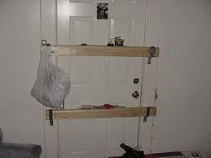
Analyzing the Barricaded Individual

Slide 29
Types of Barricaded Situations
4 types of barricade situations
Armed barricaded individual, no hostage
Armed barricaded individual, with hostage
Armed barricaded suicidal individual
Armed barricaded suicidal individual with a significant other
When is the situation beyond the capabilities of patrol officers?
Notes:
Talk about difference between high profile and low profile containment.
Risk Factors to law enforcement

Slide 30
Armed Barricaded Person
No Hostage
During the commission of a crime.
Quick response by law enforcement.
Barricades for the purpose of eluding law enforcement, visions of escape to avoid apprehension.
To avoid arrest during the execution of an arrest warrant.(fugitive)
Can easily change to a barricaded suicidal person drastically changing the risk to officers.
Suicide by police.
Notes:
I am not going back to jail scenario
High Profile vs. Low Profile containment

Slide 31
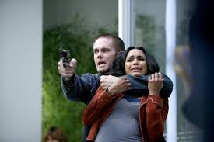
Armed Barricaded Person With Hostage
Hostage- a person being held against their will for the purpose of fulfilling certain terms.
In these situations the hostage generally has no relationship to the hostage taker.

Slide 32
Purpose of Hostage Taking
Initial act is created by survival instinct brought on by a crisis state. (spontaneous)
Hostage is used for initial barrier to keep law enforcement at a safe distance.
Hostage is used as a bargaining chip to ensure safety ,to bargain for the possibility of escape and/or substantive demands.
Notes:
Substantive Demands: money, escape, political/social change.
Hostage situations present greater opportunity for police to control the incident and influence the subject’s behavior.
High profile containment is often useful
Ask when the two most dangerous times are during a hostage situation?
Initial siege
Assault by law enforcement

Slide 33
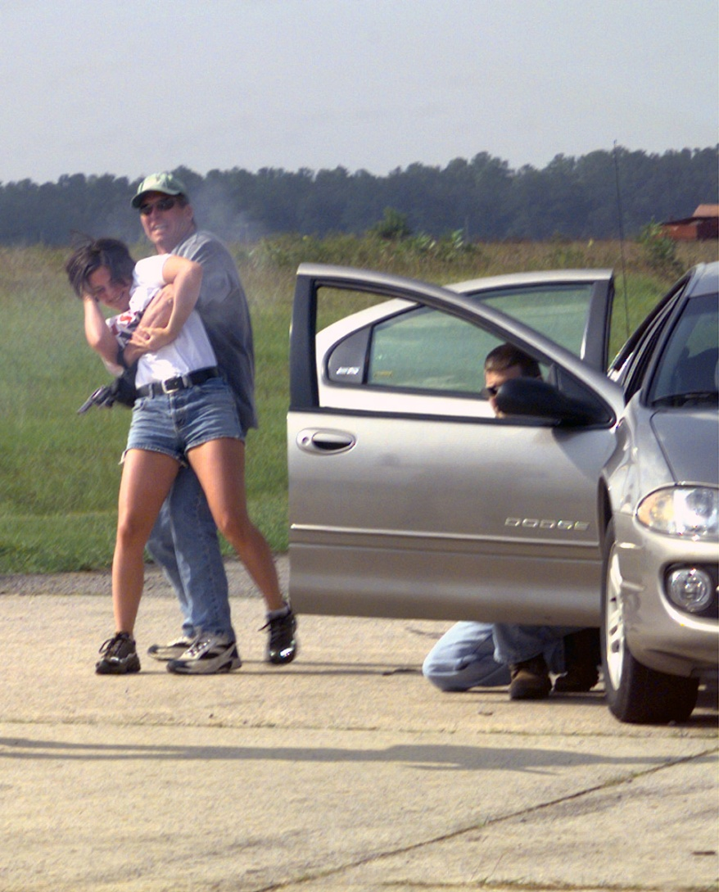
Purpose of Hostage Taking
Two most dangerous times are during the initial siege and next during an assault by law enforcement.
Hostage becomes an added barrier of protection when the hostage taker is in an extreme mode of survival.
Notes:
How do we handle a hostage situation?
Stall for time
Lower their expectations – over time their demands tend to become more realistic when they start to realize they don’t have as much control as they thought
These tactics along with subtle displays of tactical capabilities send powerful message and allow negotiator to discuss positive police actions in the form of inaction.
HIGH PROFILE CONTAINMENT

Slide 34
Armed Barricaded Suicidal Person
Barricaded due to extreme emotional problems
High levels of frustrations lead to crisis state
Action Imperative is high
Officer Safety Risk
Must manage officer created jeopardy
Be aware of suicide by police
Avoid manipulation of anxiety
Notes:
Emotional act, self destructive behavior.
Motivated by anger, rage, frustration, hurt confused or depression
Often no substantive demands or unrealistic demands
LOW PROFILE CONTAIMENT
Geno Examples:
Flash bang bean bag assault
Broken Window Example caused death (Philosophy change – my time in tact not break windows or launch gas on suicidal person

Slide 35

Armed Barricaded Suicidal Person Holding Significant Other
Homicide with suicide to follow.
Victim precipitated homicide possible.
Negotiate or Hostage Rescue
Risk factor to law enforcement is extremely high.
Notes:
What type of containment?
RISK FACTORS:
is not making demands and does not appear to need anything from police
Focus is against person held
Person being held is victim not hostage
High profile containment can make things worse
Review show of force at this point:
Limited shows of tactical capacity can help negotiations along by encouraging dialogue. It is a delicate balance.

Slide 36
Aggressive Behavior
Response to Aggressive Behavior
Overcome by physical force
Medicate
Communicate
100% possibility, small probability
We are not going to eliminate aggressive behavior , we can work to reduce it.
MINIMIZE THE OCCURRENCE AND MAXIMIZE THE SURVIVAL.
Notes:
People with Mental Illness not likely to be violent, but we don’t play it cheap
WHEN YOU FORGET THIS YOU GET HURT.
IT IS OUR RESPONSIBILITY TO ENSURE THAT WE AND THOSE AROUND US RETURN HOME EACH DAY TO OUR FAMILIES.
TRANSITION:
How do we respond to aggressive behavior?
3 options

Slide 37
How to React to Someone In Mental Health Crisis
Notes:
RECAP WHAT HAS BEEN COVERED SO FAR.
PROFESSIONALISM
INTEGRITY
DEVELOP COMMUNICATION SKILLS
TRAINING AND EXPERIENCE
CONFIDENCE
RECOGNIZE SOMEONE IN CRISIS
ANALYZE SITUATIONS TO DETERMINE WHAT BARRIERS ARE BEING SET AND HOW TO GREAK THEM DOWN
MANAGE OFFICER CREATED JEOPARDY
NOW TRANSITION TO HOW TO REACT TO SOMEONE IN CRISIS

Slide 38
Contacting An Individual In Crisis
METHODS OF CONTACT
INTRODUCTION
My name is (first name).
I am with the (Law Enforcement Agency).
“I would like to help” or “I am concerned about you. Are you alright?”
Telephone
PA System
Face to Face
Text
Email
What are the advantages and disadvantages of each?
Notes:
Text and email new to me. (What is the potential problems for the police with texting?
Introduction should be sincere and empathetic
Be ready for a one-way dialogue
Goal in a one way dialogue is to address concerns that may not have been articulated, and answer questions that haven’t been asked
JUST BECAUSE THEY ARE NOT RESPONDING DOES NOT MEAN THEY ARE NOT LISTENING
Another important tool is to emphasize positive police actions
When do we contact?: debate over verbal containment. Contact before physical containment. Have a discussion:
. Verbal Containment – occupy subject and begin to allow them to vent.

Slide 39
3 Aspects of Communication
Body language
Tone
Word Choice

Slide 40
Non-Verbal Communication/Personal Space
The physical distance maintained between the officer and the individual person in crisis may either escalate or de-escalate an encounter
The level of personal distance that individuals need to feel comfortable can vary from culture to culture, and from individual to individual
Close personal space (reserved for family members or close friends) is 1.5-4ft. Social distance (with someone who is only an acquaintance or someone you don’t know well) is 4-12ft.
Notes:
Officer safety, as well as the behavior of the individual, must be taken in consideration when determining the appropriate and safe distance between the officer and the individual during an encounter.
When personal space is closed (i.e. escorting the individual outside, the placing on of handcuffs, etc.) officer safety, and the safety of the individual, is vital
Appropriate eye contact on the part of the officer during an encounter with individual experiencing a mental health challenge or acute episode of a mental health crisis will help engage the officer with the individual, and can communicate a sense of respect, understanding, and empathy.
Inappropriate eye contact on the part of the officer, such as staring, raised eyebrows, etc. can convey disrespect, or a threatening and intimidating attitude.
Conversely, similar eye contact on the part of the individual in crisis may convey mistrust, anger, or hostility.

Slide 41
How does Time Affect De-escalation?
Time (passage of time) generally has a positive effect on crisis intervention
Reduces time
Increases rational thinking
At the onset of a crisis situation everyone’s anxieties are high which has a negative affect on rational thinking

Slide 42
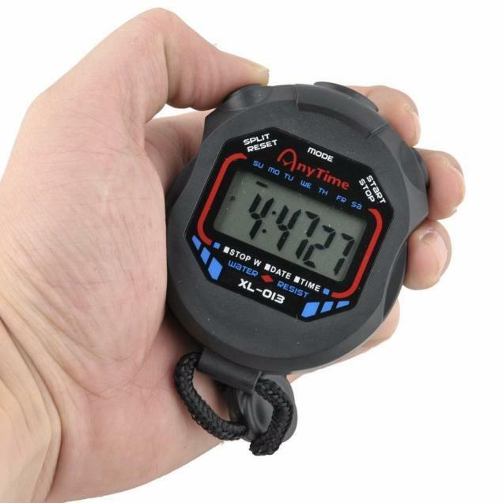
Potential Negative Effects of Time
Action imperative
Exhaustion/boredom
Creeping up effect
Injuries/illness
Weather conditions
Staffing issues
Supervisor pressure
Media and public pressure

Slide 43
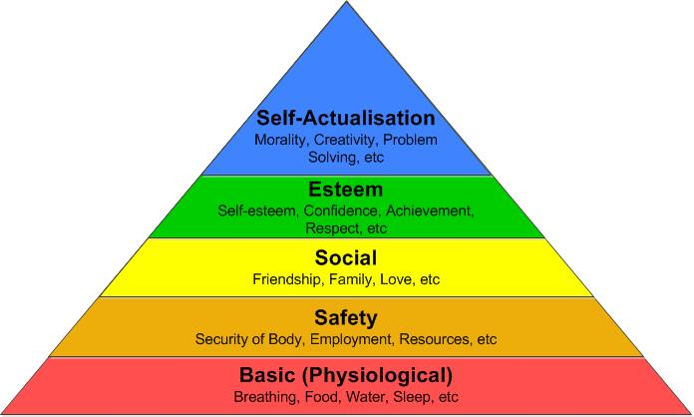
ADDRESS BASIC HUMAN NEEDS
Security
Recognition
Control
Dignity
Accomplishment
Respect
Notes:
Security: physical and emotional
Recognition: his view is understood (I have her view, but I know that is only half the story)
Control: feels he has some say (HOSPTIAL)
Dignity: save face (help them see that this is not the end of the world) (BLAME ME) (ANYONE COULD BE SUICIDAL)
Accomplishment (achieved something)
When an officer begins to address these basic human needs they begin to build a bond and establish trust.
Respect - a feeling or understanding that someone or something is important, serious, etc., and should be treated in an appropriate way

Slide 44
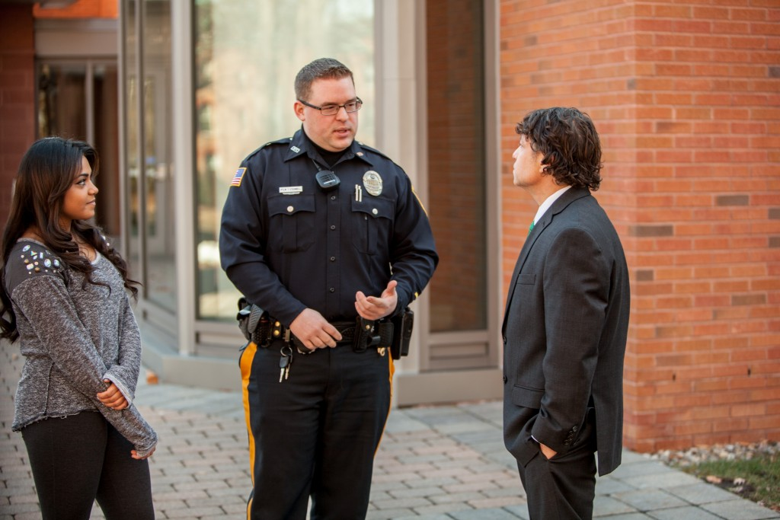
What is Conflict Resolution?
Recognizing, defusing and controlling aggressive behavior through the use of crisis intervention techniques, therapeutic communications in conjunction with an understanding of attitudes, emotions and behavior.

Slide 45
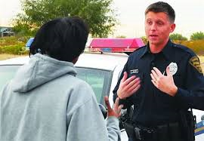
Benefits of Conflict Resolution
Law Enforcement officers who develop communication skills will be more effective and less likely to use higher levels of force.
Notes:
Use of Force dropped dramatically
Better interviewer, less complaints
PED CHECK EXAMPLE

Slide 46
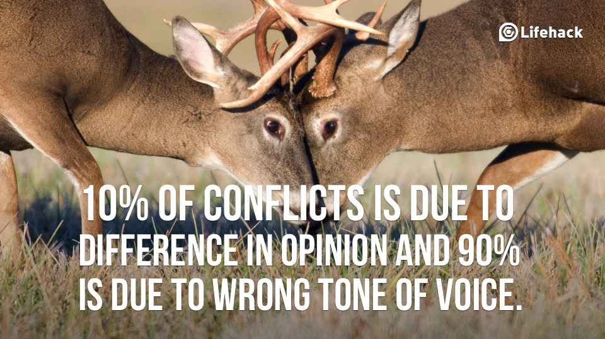
Benefits of Conflict Resolution
Increased Law Enforcement effectiveness
Stronger support from the community
Fewer complaints and law suits
Reduced job related stress
Improved odds of safety and survival
Notes:
Stronger support from the community – WHO KNOWS ABOUT CIT?
Reduced job related stress –FEEDBACK FROM THE COMMUNITY
TRANSITION TO NEXT SLIDE: Who is a crisis communicator?
PERCEPTION IS A CRISIS COMMUNICATOR IS THAT GUY THAT TALKS TO PEOPLE OVER THE PHONE (AN EXPERT)

Slide 47
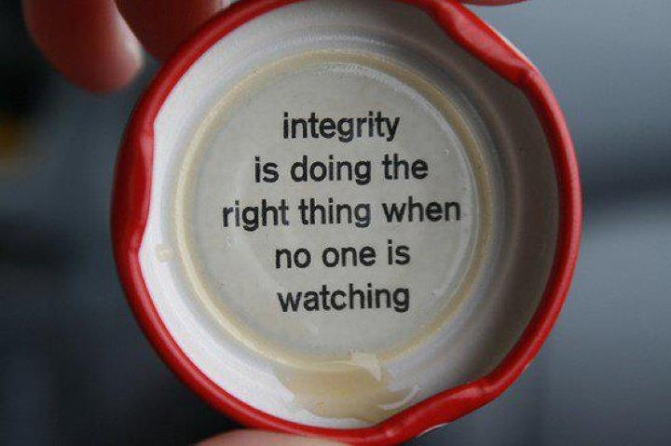
Conduct yourself with Integrity
Notes:
General S’s Speech. We learn someone’s true character by what they do when nobody is watching
One bad action can undo 100 good actions
St. Ann Cop’s Example
Powell shooting
News wants to talk when something goes bad, but they never want to talk to me about the 60 or 70 times a week that officers do a good job and it does not come to the attention of anyone.

Slide 48
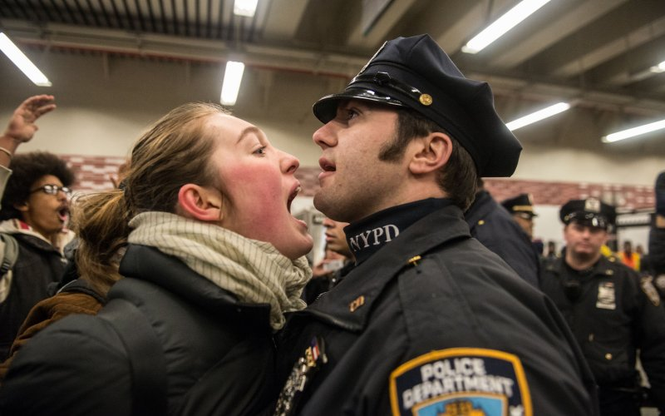
Maintain Professionalism
the skill, good judgment, and polite behavior that is expected from a person who is trained to do a job well
(Merriam Webster)
Notes:
Attitudes (egos): First day of Tact Speech
Morals/Judgments: put that aside FBI role-play try to shock them.
Patience: time invested at front end pays off in the back end

Slide 49
Maturity
In psychology, maturity is the ability to respond to the environment in an appropriate manner. This response is generally learned rather than instinctive. Maturity also encompasses being aware of the correct time and place to behave and knowing when to act, according to the circumstances and the culture of the society one lives in
Notes:
Everybody is probably thinking about someone right now that is the opposite of mature.

Slide 50
MATURITY
People in order to compensate for lack of maturity and emotional strength, borrow strength from their position, power, credentials, seniority, and affiliations in order to obtain a win/lose outcome.
Poor skills feed frustration which in turn feeds an immature response.
Notes:
Leaders who hide behind their rank.
Leadership: “The art of inspiring people to cooperate and to take action enthusiastically toward the achievement of uncommon goals”
Respect is earned. Kurt Frisz training example.
Win/Lose vs compromise. Example of choosing the hospital.
Maturity/Leadership – Ability and willingness to delegate
Prevents OBE (Overwhelmed By Events) –
OBE causes shouting and subordinates, countermanding previous orders, confusion or anxiety. Eventually they will implode.
Causes of OBE are too large a span of control and need for excessive control (micromanager)
Frisz and 10-40’s (advice of the experts)

Slide 51
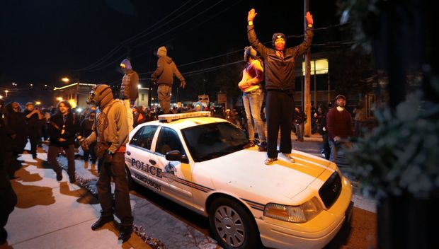
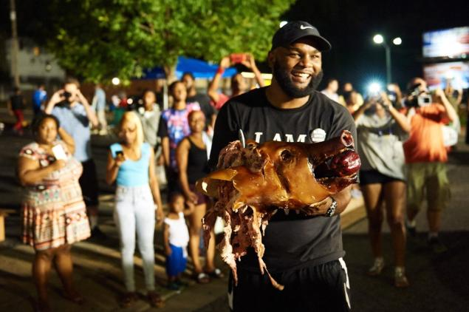
Maturity and Respect
If you appreciate another persons sense of dignity, self worth, curiosity, and healthy suspicion then you will never be upset by people who initially challenge your authority
Notes:
Remember a person may have legitimately had a bad experience with the police in the past.
Racial profiling example.
Were people at Ferguson with legitimate complaints
Officer Friendly
Easter Night Barricaded subject Example

Slide 52
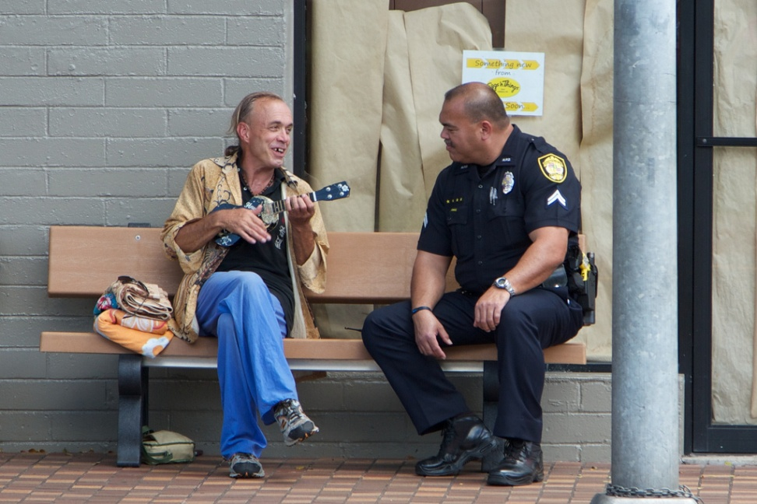
Remember Perception is Reality
We are in a high profiled occupation and are constantly being observed and evaluated. Not only by the public, the media and other departments and agencies but also by other officers.
Notes:
FERGUSON ADDED A WHOLE NEW DIMENSION TO THIS (Camera phones, media)
Invest the time.
Officers positive response and investment of time at the beginning builds trust and rapport while leaving a lasting favorable impression when we have to intervene later.

Slide 53
Officer Bearing
The professionalism of an officer is more than just the outward appearance of his or her uniform, it is the manner in which he or she carries themselves and interacts with the public on a daily basis. Maintaining one’s Officer Bearing is paramount during times of stress as an officer represents an organization much bigger than oneself or even their department. Officers are a reflection of the law enforcement in its entirety as well as of the community. It is imperative that officers, not even for a moment, lose their bearing; for once it is lost, it can never fully be regained.
Notes:
WHEN SOMEONE IN YOUR ORGANIZATION TREATS PEOPLE POORLY WITHOUT RESPECT THEY LOWER YOUR CREDIBILITY AND EVERYONE ELSE YOU WORK WITH.
St. Ann officer with rifle in Ferguson
Over shadows the hundreds of officers that handled themselves well

Slide 54
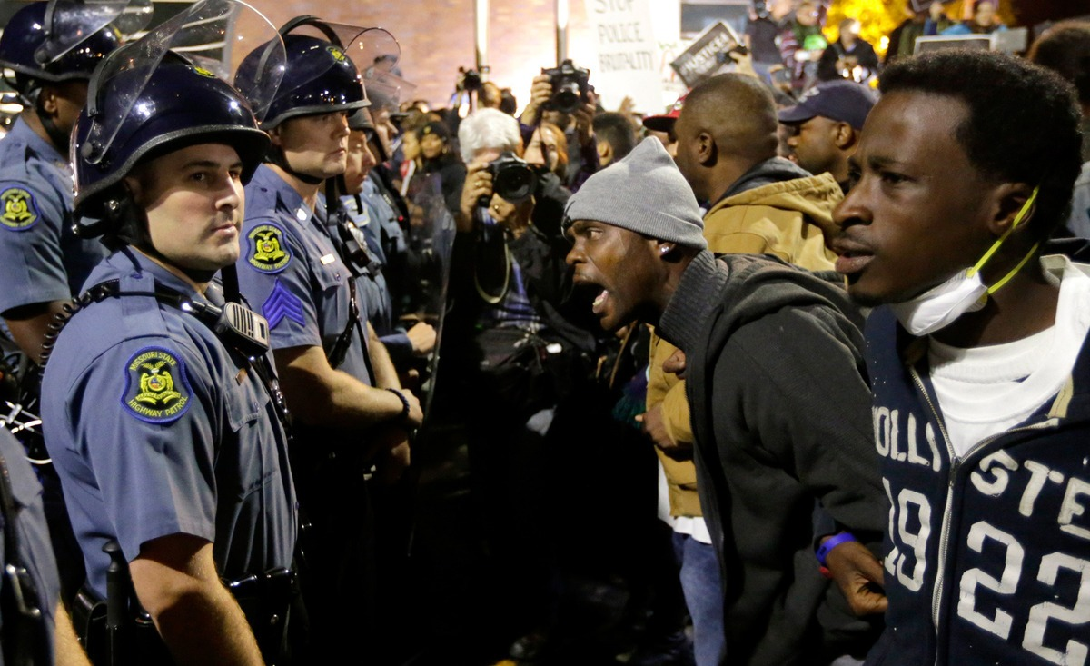
Maintain Self-Control
When confronted, with a difficult subject, the first step is not to control their behavior, but to control your own behavior
The only aspect of a crisis situation that we have absolute control over is our own Emotions
Notes:
DON’T TAKE IT PERSONNAL
Most critical skill of law enforcement negotiator is to control self and those around them.
Not to overreact to threats and see the meaning of defensive threats. “I’ll kill this lady if you try to come in here”

Slide 55
CONFIDENCE
Training + Maturity + Experience =
CONFIDENCE
With Confidence:
Good decision making
Increase Safety
Reduce Liability

Slide 56

What if we lack Confidence?
Act Confident
Look Confident
You will feel more confident
Others will have more confidence in you and your abilities
Notes:
FAKE IT UNTIL YOU MAKE IT
DUCK ON A POND

Slide 57

Action Imperative Mindset
Law enforcement officers often feel a need to act in order to solve the problem quickly
We get pressure from peers, the public, media, supervisors etc.
Taking action unnecessarily can cause a domino effect resulting in needless loss of life

Slide 58
Officer Created Jeopardy
When officers deviate from established tactics or policies and his/her actions unnecessarily place him or others at greater risk or harm
Notes:
What causes OCJ?
Failure to adapt to changing conditions
Lack of knowledge and experience
Inability to apply knowledge in a strategic and tactical way to changing conditions
False sense of urgency coupled with an impulsive response (Action Imperative mindset)

Slide 59
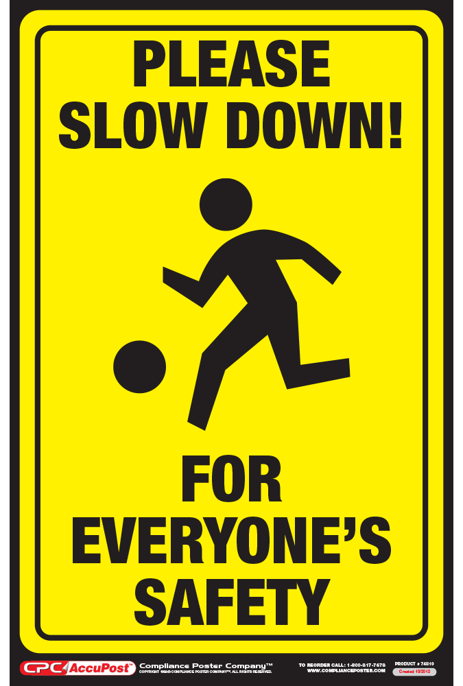
Force Avoidance
Properly evaluate the situation
Unless justified, do not put yourself in a situation which requires the use of force
Officers must not force a confrontation when he/she has a position of tactical advantage
(Tactical Disengagement)
Notes:
Ask Why am I doing this now?
Are there less risky alternatives available? K9 and Tact open air
Tactical disengagement- Tactical Retreat
REPOSITION – When you show up on scene you do not step into concrete shoes.

Slide 60
Managing Officer Created Jeopardy
Officers should respect barriers, reducing the chances of placing their self in a position that may give an individual the opportunity to capitalize on his or her intention of Victim Precipitated Homicide.
Why?
Notes:
Why manage officer created jeopardy?
Safety
Liability
Ask:
Is this action necessary?
What are the risk factors? How can this go wrong?
Is it acceptable?
Why take this action now instead of 10 minutes ago or 10 minutes from now
What conditions have changed?
Is there a less risky alternative?
Breaking cover. We may have to take someone’s life, but we should not do anything that increases the likelihood we will have to do that.
Leverage Point: a critical time, place, step or event in a system where force can be applied to make a change:
Too soon can be bad or too late can result in a missed opportunity
BREAK

Slide 61
“Voice” - Your #1 Tool
The WAY something is said can be 5x more important than What is said.
Tone of voice, demeanor & projected sincerity are more important than any single phrase that you may use.
Remember:
Calm is just as contagious as fear or panic
Notes:
Negotiator class for tact officers
Lowering Your voice will often cause them to lower theirs
Talk at the level you want them to talk

Slide 62
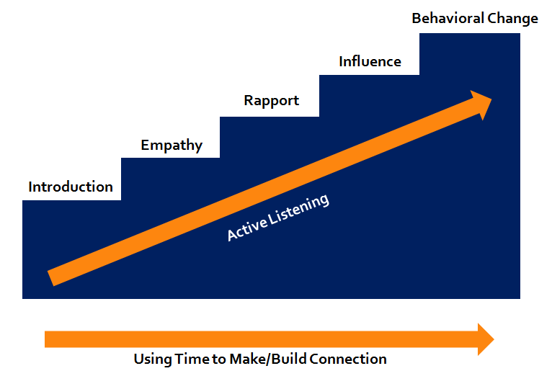
Behavioral Change Stairway

Slide 63
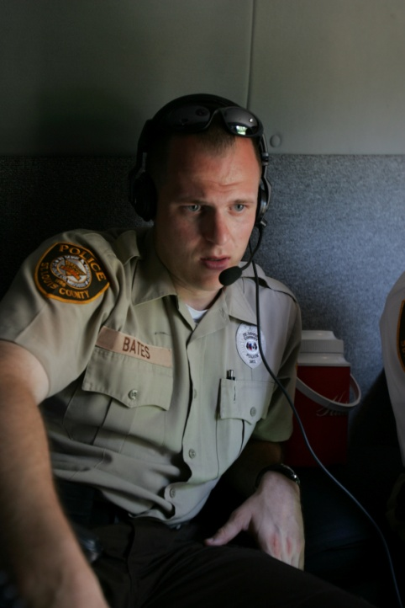
THE ART OF LISTENING
ACTIVE LISTENING
Notes:
Get them talking is huge obstacle to overcome

Slide 64
Listening
We all have a basic need to be heard
We speak so that someone will listen
We speak to influence people
We speak to rationalize our behavior
Effective listening is as active as talking

Slide 65
Nonjudgmental Active Listening
Most people are either speaking or preparing to speak.
Objectives of Active Listening
Lower emotions and return subject to “normal”
Establish rapport and influence
Gather information
Encourage behavioral change

Slide 66
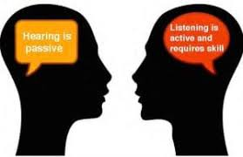
Active Listening Skills
“I” Statements
Open Ended Questions
Explicit Phrases
Minimal encouragers
(non-committal response)
Effective pauses/Silence
Notes:
“I” messages - instead of you. You sounds accusatory
Open ended questions
Who, What, Where, When and How
Directs or compels the subject to reply with more than a yes or no answer.
Elicits conversation
Explicit Phrases
Tell me more about that, Tell me more, Let’s discuss it, Go ahead I’m listening, I’d be interested in your point of view
Minimal encouragers
Oh, Is that right, Really, OK, Interesting
Effective Pauses
A pause is a cue for someone else to start talking or a period of time used to gather thoughts
Silence is a sign of good listening and empathy. However, most people are not comfortable with extended silence so they will fill it with conversation
Gauge progress

Slide 67

Active Listening Skills
Reflecting
Mirroring
Paraphrasing or Summarizing
Emotion Labeling
Notes:
Reflecting – the process of paraphrasing and restating both the feelings and words of the speaker
Purpose: allow the speaker to hear their own thoughts, show speaker you are trying to perceive the world as they see it, encourage them to continue talking.
Mirroring – a form of reflecting involves repeating almost exactly what the speaker says. Can be as simple as repeating the last few words spoken and encourages the speaker to continue. Don’t over mirror.
Paraphrasing – or Summarizing - using other words to reflect what the speaker has said. Shows you are listening and trying to understand what the speaker is saying
WHAT IF I GET IT WRONG?
Emotion Labeling.

Slide 68
Empathy
“Identification/Understanding of another’s situation, feelings and motive.”
PLACING YOURSELF IN SOMEONE ELSE’S POSITION AND SEEING THE WORLD THROUGH THEIR EYES
You do not have to feel what they feel or agree with them to provide empathy
Notes:
Empathy is not Sympathy - Sympathy is an expression of pity or sorrow for the distress of another.

Slide 69
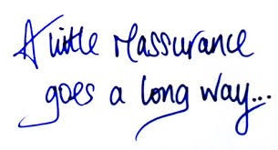

Reassurance and Validation
Say or do something to remove an individuals doubts or fears
Recognition or affirmation that a person or their feelings or opinions are valid or worthwhile

Slide 70

Provide Support
Respect and dignity
Avoid Blame
Give subject hope
Have realistic expectations
Provide the subject with appropriate resources and help
Provide reassurance
Notes:
Difference between information and reassurance. Information is not guidance, but helping person understand what they are going through and experiencing. Example: “Many people have gone through similar experience”s
ACTIVE LISTENING – EMPATHY - RAPPORT – INFLUENCE – BEHAVIOR CHANGE
TRANSITION
BARRIERS TO ACTIVE LISTENING

Slide 71
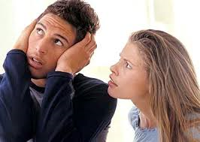
BARRIERS TO ACTIVE LISTENING

Slide 72
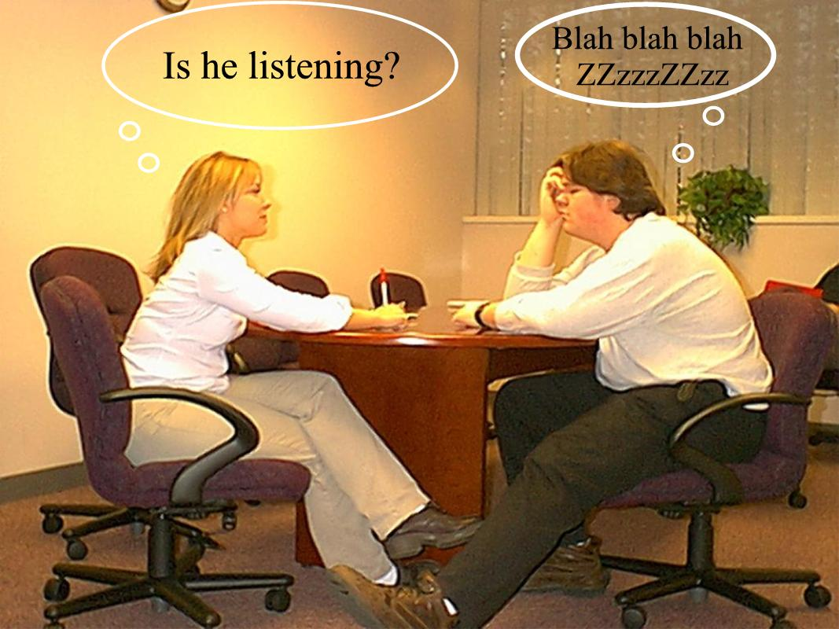
Barriers to Active Listening
Advice, Judgment, problem solving or Persuasion
Pushing a conversation about Crisis Situation
Comparing
Interrupting
Arguing
Notes:
Identification of Interests
Deer Hunting discussion

Slide 73
Phrases That Damage Rapport
“Calm Down”
  May be perceived as an order.
“I Understand”
  Often the phrase used by others to interrupt and jump into problem solving.
  Understanding must be demonstrated.

Slide 74
Phrases That Damage Rapport
Why?”
  Feels accusatory, creates defensiveness.
“You Should” & “You Shouldn’t”
  Judgmental statements that may cause feelings of inadequacy/shame/anger.
Notes:
74

Slide 75
Better Phrases
Calm Down
“I Understand”
“You Should(n’t)”
“Why?”
“I can see (hear) how
angry you are”
“I’m listening.”
“What’s causing that?”

Slide 76
No “Zingers!!”
If you really want to say something, and you can just taste how good those words will feel…
they’re probably wrong.
Notes:
Drunk woman example
Traffic stop example
76

Slide 77

Other Things You Should Not Do When Interacting With Someone In Crisis
Tell them to “snap out of it”
Be sarcastic
Problem solve
Make light of their experiences

Slide 78
Other Things You Should Not Do When Interacting With Someone In Crisis
Dismiss their feelings
Treat suicidal individuals like they are criminals
Treat someone with mental illness as unintelligent
Expect rapport to develop quickly
Trivialize their problems
Argue moral issues
Notes:
Homosexual student role play at FBI
Listening to Juveniles is a huge Rapport Builder

Slide 79
When Interacting With Individuals Exhibiting Signs of Psychosis
DO
DON’T
Avoid rapid movements
Explain your actions and requests
Keep voice down and speak slow and clear
Be ready to repeat yourself
Whisper, joke or laugh
Don’t lie or be deceptive
Argue about their delusions
Take delusional comments personally
Notes:
DO
Explain actions and requests: handcuffing, hands in pockets
DON’T
Whisper or joke (suspicion)
Don’t lie (will see them again)
Argue about delusions (not going to win that battle)

Slide 80
Communicating with a Delusional or Hallucinating Individual
An officer should NEVER endorse a clearly false idea.
Endorsing a delusion or hallucination (e.g. “Yes, I people with black suits all over the place. They are out to get everyone.” “I see the burn marks too….we should get you to the hospital right away.”) can create a difficult situation for the officer as well as for the individual experiencing the delusion/hallucination.

Slide 81
Communicating with a Delusional or Hallucinating Individual
Although an officer may believe that it will help the individual feel relieved to think that they are not alone in their delusions/hallucinations, it will only solidify the delusion/hallucination in the individuals mind and make it more difficult for them to know what is real and what is not. (e.g. “See? Even the police say that the government is out to get me. So it must be true!”)

Slide 82
Communicating with a Delusional or Hallucinating Individual
An officer must remain honest during their communication with the individual. Honesty, followed by empathy, creates a sense of trust and openness between the officer and the individual.
Statement: “Look at all of those people looking at me and yelling horrible things to me! You must see and hear them too, don’t you?”
  Sample response: “No, I don’t see or hear anyone other than you. But seeing other people and hearing them yell at you must be pretty terrifying for you.”

Slide 83
Communicating with a Delusional or Hallucinating Individual
Soliciting information about the delusion or hallucination
An individual’s delusions/hallucinations can create an officer safety concern. Therefore, it is important for an officer to solicit as much information as possible on the delusions/hallucinations the person is experiencing.
Statement: “The voices in my head keep telling me to do bad things.”
  Sample response: “That must be hard for you. Can you tell me what the voices are telling you to do?”
  Statement: “They are telling me that I should kill you.”
Notes:
NOTE: If an officer fails to ask questions about the delusions/hallucinations an individual is experiencing, important officer and/or public safety concerns can be easily missed.

Slide 84
Deadlines and Demands
DEADLINES
DEMANDS
Contact prior to deadline and talk through it
Avoid referring to deadline
Do not set your own deadlines
Blame “boss” or “red tape” for issues
Leave me alone
Talk to loved one
Notes:
DEMANDS
Do we demand something for everything we give them? Discuss
Depends: Hostage situations probably yes because they have substantive demands.
Non Hostage maybe not because they do not have demands and giving in to minor requests can help build rapport and enhance dialogue
Avoid saying no outright. “I’ll pass that on, but I know it’s going to be a problem
Soften and reframe
Get something in return – bullet for water
Don’t bring up old demands – outrageous demands when emotions are high
Most common demand is for law enforcement to leave them alone and go away. (Geno medic example) Kid wanted to be medic and asked what he would do if a soldier was telling him to leave him alone.
Talk to loved ones – unsatisfied needs motivate. Agree to allow them to talk after compliant surrender (Steak and Shake Example)
We do not give weapons, drugs, exchange hostages, provide transportation GENO MEDIC EXAMPLE
Briefly discuss Third Party Intermediaries:
Very difficult to control
May have their own agenda that you are not aware of.
Exposes them to danger
We rarely know enough about relationships between friends and family members to know if they can help: Advanced technique after much deliberation
HOW DO WE KNOW IF THINGS ARE GOING DOWNHILL OR WE ARE MAKING PROGRESS?

Slide 85
Indicators Of Risk
Continued clear threats
Actual injury to victims/hostages
No substantive demands
No escape demands
Verbal statements about death, dying or suicide
feeling hopeless, worthless or lacking purpose
Dramatic changes in mood

Slide 86
Indicators of Progress
Shift from threatening to non-threatening language
Disclosure of personal info
Discussion of topics unrelated to the ongoing incident
Lowering voice and/or emotions
Slowing of speech pattern
Longer conversations
Desire to speak to officer
Less violent unpredictable behavior
Release of hostages
Deadlines pass without incident
Development of rapport
Following officer’s suggestions
Notes:
Common Questions: 1. how long will this last 2. is the team making progress
Can’t answer number #1.
Deadlines pass without incident – can help save face.

Slide 87
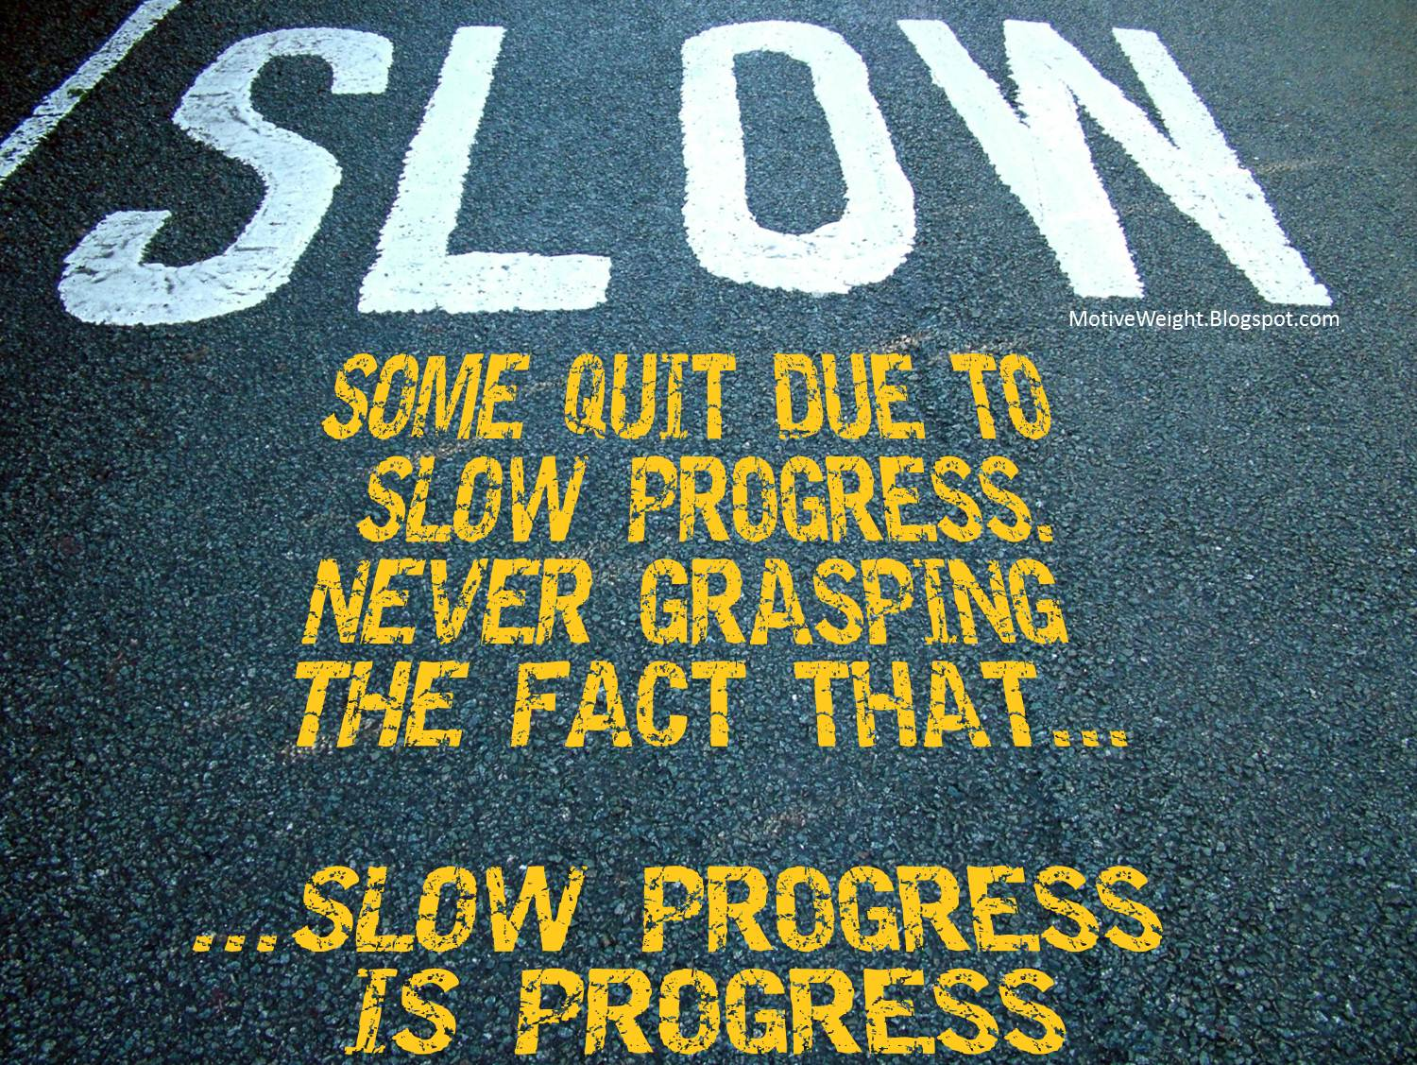
Indicators of Progress
No additional injuries
Subject is becoming more rational
Increasingly willing to bargain
Lowered demands
Questions about consequences of surrender
Notes:
TIME LIMITS CAUSE BAD THINGS TO HAPPEN – GARY NOESNER HOSTAGE BAD EXAMPLE

Slide 88
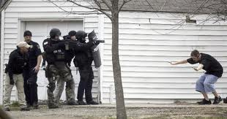
Behavioral Change
SLOW DOWN
Address anxiety about coming out
Describe the entire process
Have them repeat process back to you
Make sure receiving officers know the plan
Notes:
Help them visualize the process
Use terms like When you come out instead of if
Do not ask them to walk out carrying the weapon or in some cases hostages (baby)
Bring them to you. If they won’t come to you than you have more communication to do
AFTON GARAGE GOOD EXAMPLE

Slide 89
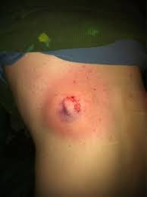
You can go back to crisis intervention after a verbal mistake, but it is hard to go back crisis intervention from a tactical mistake.
Notes:
Draw a line in the sand.
Could be testing you by coming out a little ways
ACTIVE LISTENING – EMPATHY - RAPPORT – INFLUENCE – BEHAVIOR CHANGE (SURRENDER)
THIS IS A CRITICAL TIME AND YOU ARE ALMOST THERE

Slide 90
Sources
Applied Suicide Intervention Skills Training (2007) Behavioral Health Response, St. Louis, Missouri.
Crisis Intervention Team Training (2008) St. Louis County and Municipal Police Academy, St. Louis, Missouri.
CTS Less Lethal Instructor Certification Course (2008) St. Louis County and Municipal PoliceAcademy, St. Louis, Missouri.
Dorough, Louis, Basic Negotiations Course (2005) St. Louis County Emergency Operations Center
Dorough, Louis (2002) Compliant Surrender: A Practical Guide to Law Enforcement Negotiations. Hardbound Inc., Florissant, Missouri

Slide 91
Sources
Castellano-Hoyt, Don W. (2003) Enhancing Police Response to Persons in Mental Health Crisis. Charles C. Thomas Publisher, LTD., Springfield, Illinois.
F.B.I. Basic Negotiations Course (2006) Forest Park Community College, St. Louis Missouri
Hammond, Grant T. (2001) The Mind of War: John Boyd and American Security. Smithsonian Books, Washington D.C.
Heal, Charles (2012) Field Command. Lanturn Books, New York
McMahon, Deborah, Basic Crisis Negotiations Course (2008) Midwest Counter Drug Training Center; Camp Dodge, Iowa

Slide 92
Sources
Lord, Vivian B. (2004) Suicide By Cop: Inducing Officers to Shoot. Practical
  Direction for Recognition, Resolution and Recovery. Looseleaf Law
  Publications, Inc. Flushing, New York.
McMahon, Deborah, Negotiating in a School Environment (2009) Midwest County Drug Training Center; Camp Dodge, Iowa.
Mental Health First Aid Training (2013) Behavioral Health Response, St. Louis, Missouri
Murphy, Dan; Sherman, Luke, Resolution of a Barricaded Incident Course (2007) National Tactical Officers Association Conference, Millwaukee, Wisconsin.

Slide 93
Sources
Noesner, Gary (2010) Stalling for Time: My Life As An FBI Negotiator. Random House, New York
Planning for High Risk Events Level One Course (2007) St. Louis County and Municipal PoliceAcademy, St. Louis, Missouri
Planning for High Risk Events Level Two Course (2008) Midwest Counter Drug Training Center, Camp Dodge, Iowa.
Planning for High Risk Events Level Three Course (2009) Midwest Counter Drug TrainingCenter, Camp Dodge, Iowa.
Police Executive Research Forum ICAT Training Meeting (December 13 and 14, 2016) New Orleans, Louisiana.

Slide 94
Sources
Veterans Crisis Intervention Team Training (2013) Veterans Administration, Kansas City, Missouri.
Whitson, Don, Less Lethal/Flash Sound Diversionary Device/Chemical Agent Certification Course (2005) National Tactical Officers Association, Kent, Ohio
Youth Crisis Intervention Team Training (2012) St. Louis County and Municipal Police Academy, St. Louis, Missouri.

Slide 95
QUESTIONS
Jeremy Romo
St. Louis County Police Department
Office: 314-615-5942
Mobile: 314-650-3390
jfromo@stlouiscountymo.gov

